Slide 1
MIT Research: Effects of Inflation and Volatility on Construction Alternatives
Notes:
Life-Cycle Cost Analysis (LCCA) is an analytical tool that provides a cost comparison between two or more competing design alternatives that provide equivalent benefits for the project being analyzed.
Most LCCAs assume all construction materials have constant real prices. This assumption is the same as assuming that all commodity prices go up with general inflation. When prices rise more (or less) than expected, the projects with larger future costs will be unfairly advantaged (or penalized).

Slide 2


MIT Concrete Sustainability Hub
$10 million investment over 5 years
Funded equally by RMCREF & PCA
NRMCA providing technical support and guidance
NRMCA and state associations to play a critical role in the technology transfer
Notes:
In 2009, the Ready Mixed Concrete Research & Education Foundation partnered with PCA to establish the Concrete Sustainability Hub at MIT
Funded by a $10 million investment over next 5 years, the Hub has three principal goals:
Identify areas in which concrete excels compared to other materials
Identify opportunities for improvements
Create solid technical basis for future industry development

Slide 3
Goals
Identify areas in which concrete excels
Identify opportunities for improvement
Create solid technical basis for future industry development
Social
Environment
Economic
Sustainable
Notes:
The goals of the research are:
Identify areas in which concrete excels
Identify opportunities for improvement
Create solid technical basis for future industry development

Slide 4
3 Research Platforms
Concrete Science
Scientific breakthroughs toward reducing the CO₂ footprint of cement and concrete
Econometrics
Impact on economy:
- System dynamics
- Effect on policy (e.g. Carbon Tax
Building Technology
The CO₂ footprint of concrete structures
- Material Flows
- Life Cycle Assessment
Notes:
The Hub is organized into three areas or platforms:
Concrete Science
Building Technology
And Econometrics
This interdisciplinary approach will provide us a unique opportunity to:
Develop a comprehensive analysis of where we are today
Be leaders in advancing even greater sustainability in construction
And better understand the economic impacts of sustainable construction solutions
MIT has truly assembled a “dream team” of researchers to work together through the Hub.

Slide 5
Life-Cycle Cost Analysis: The Basics
Initial Construction Costs
Net
Present
Value, $
Rehabilitation Activity Costs
Maintenance Activity Costs
Discount
to
Present
Value
LCCA Analysis Period, yrs
Salvage Value
Notes:
Costs are calculated in terms of the Net Present Value (NPV), accounting for initial construction costs and future costs including maintenance, rehabilitation and salvage.

Slide 6
Discount Rate
To estimate net present value, future benefits and costs must be discounted.
Discount factors can be reflected in real or nominal terms.
Real Discount Rate - real interest rates from which the inflation premium has been removed (OMB Circular A-94 Appendix C).
Notes:
Within the LCCA framework, it is important to account for the time value of money so that the NPV of future activities can be determined.
In the construction industry the time value of money is typically determined based on the real discount rate which is a function of the anticipated market interest rate less the rate of inflation over the anticipated life of a project. Using the real discount rate implies that the inflation rate of all construction materials matches the general rate of inflation, inferring that the real costs are fixed over time for all building materials.

Slide 7
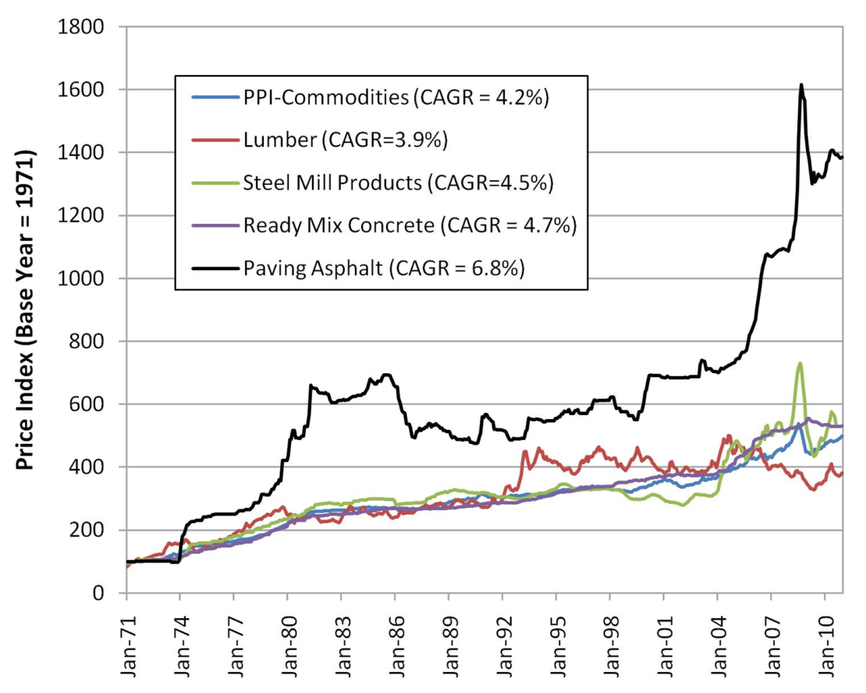
Are Real Costs Constant?
MIT investigated the historical inflation rates of:
wood,
steel,
concrete, and
asphalt.
Result - inflation rates are quite different.
Notes:
Recent research at the Massachusetts Institute of Technology (MIT) examined historical data on real prices and found that the assumption of constant real costs is inconsistent with historical experience. MIT investigated the historical inflation rates of several construction materials (wood, steel, concrete, and asphalt) and demonstrated that the historical inflation rates for these materials has been quite different.

Slide 8
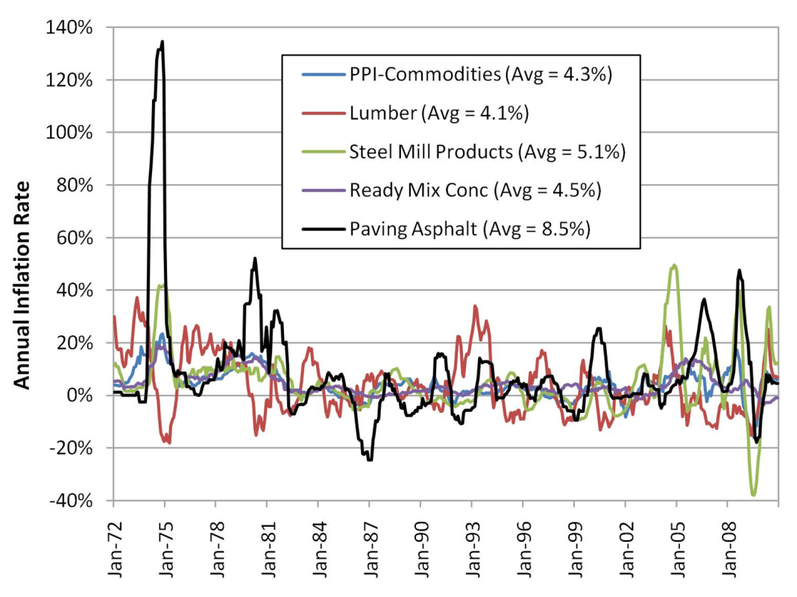
Are Real Costs Constant?
MIT also investigated the historical volatility of the same materials.
Result – volatility is also quite different, especially in the case of asphalt.
Notes:
and in the case of asphalt has been highly volatile.

Slide 9
Methodology
Conducted a LCCA for an assumed 10-mile, four-lane highway project.
Concrete and asphalt alternatives analyzed using standard designs and maint/rehab schedules.
Performed Monte-Carlo stochastic simulation of 1,000 different LCCA outcomes and historical inflation rates.
Generated a variety of different random possible outcomes.
Notes:
To demonstrate the effect of variable inflation rates, MIT performed a LCCA for an assumed ten-mile, four-lane highway project. A concrete and asphalt alternative were analyzed using standard North Carolina DOT pavement designs and maintenance/rehabilitation strategies. MIT performed a stochastic simulation of 1,000 different LCCA outcomes using a Monte-Carlo simulation and historical inflation rates which generated a variety of different random possible outcomes.

Slide 10
Results – Inflation Rate
In 86% of the simulations the real price of concrete fell over the maintenance period.
In 85% of the simulations asphalt’s real price rose over the course of 40 years.
The cost surprise exceeded 4% of the initial projected cost (on a NPV basis) in half of the cases.
Notes:
It is likely that the actual costs for concrete maintenance would be lower than those assuming constant real costs (as in a typical LCCA)―in 86% of the simulations the real price of concrete fell over the maintenance period.
Asphalt inflation is likely to outstrip overall inflation, meaning that an LCCA assuming constant real costs will exaggerate asphalt’s price competitiveness―in 85% of the simulations asphalt’s real price rose over the course of 40 years.
Based on this analysis, the cost surprise exceeded 4% of the initial projected cost (on a NPV basis) in half of the cases, usually because the asphalt construction turned out to be relatively more expensive than concrete construction.

Slide 11
Results – Price Behavior & Volatility
Asphalt has risen 1.25% per year on average.
Concrete has declined nearly 0.20% in real terms over the same timeframe.
Concrete’s real price volatility is low at 2.9% while asphalt’s volatility is substantially higher at 6.3%.
Lumber and steel’s real price volatility is even higher at three times more than concrete.
Note: Data from the Bureau of Labor Statistics (BLS) for a period of more than 30 years.
Notes:
MIT analyzed the real price behavior of wood, steel, concrete and asphalt using data from the Bureau of Labor Statistics (BLS) for a period of more than 30 years and found: (See slide)

Slide 12
Results – Escalation Rate
Based on a 50 year analysis which accounts for differential inflation rates of construction materials:
Asphalt’s real cost would rise by nearly 95%.
The mean annual real escalation rate of concrete is –0.5% while asphalt’s rate is +1.1%.
Notes:
To account for the variable inflation rate of various construction materials, analysts could use an escalation rate to account for the difference in inflation between building materials and the general rate of inflation. MIT conducted another stochastic simulation for 1000 real cost paths for the four basic construction materials over a period of 50 years and found: (See Slide)

Slide 13
Impacts for Transportation Projects
In terms of equality for pavement type selection and LCCA, consider:
Asphalt’s 40-year historical inflation rate is 2% to 4% higher than that of concrete.
There is sufficient historical and forecasting evidence that demonstrates this difference will continue in the future.
Notes:
LCCA for road construction is used to determine which pavement design is most cost effective over the analysis period. For LCCA to be reliable, both the engineering inputs and the economic inputs need to accurately reflect the future performance and the time value of money. Current practice assumes that the inflation rate for all materials is the same; however, MIT has demonstrated that this is not the case and determined:
Asphalt’s 40-year historical inflation rate is 2% to 4% higher than that of concrete
There is sufficient historical and forecasting evidence that demonstrates this difference will continue in the future

Slide 14
Recommendations
Continue use of the Office of Management and Budget (OMB) recommended real discount rates in LCCA.
For pavements it is recommended to use the 30-year real discount rate.
For other structures it is recommended to use the 50-year real discount rate (or other appropriate timeframe).
Account for differences in inflation among materials and the general rate of inflation by using an appropriate escalation rate applied at the year(s) of rehabilitation.
Notes:
Recommendations for improving LCCA for construction material selection include: (See Slide)

Slide 15
Example – Accounting for Variable Inflation Rates
AC Pavement*
PCC Pavement*
Initial Construction $8m
Yr 10 – 2” O/L $800k
Yr 20 – 3” Mill&O/L $1,500k
Yr 30 – CS/Patch $300k
Yr 35 – 2” Mill&O/L $1,000k
Yr 40 – Reconstruct
Initial Construction $10m
Yr 20 – Joint Seal $200k
Yr 30 – Joint/Patch $750k
Yr 40 – Reconstruct
*Assume equal costs of maintenance throughout life cycle for both pavement types

Slide 16
Example - continued
Based on Historical Data:
Overall Inflation Rate = 4.2% (~40 yrs from PPI)
Overall Real Discount Rate = 3.0% (DOTs, OMB)
Asphalt Concrete Inflation Rate = 6.8% (CAGR*)
Concrete Inflation Rate = 4.7% (CAGR*)
Nominal Discount Rate = 4.2% + 3.0% =7.2%
Real Discount Rate
Asphalt = 7.2% - 6.8% = 0.4%
Concrete = 7.2% - 4.7% = 2.5%
*CAGR = Compound Annual Growth Rate = smoothed annualized gain over a given time period

Slide 17
Example - continued
Assume Constant Real Discount Rate
PV AC = $ 9,929,400 (DR = 3.0%)
PV PCC = $10,419,730 (DR = 3.0%)
Difference $ 490,330 (NPV AC is Lower)
Assume Product Specific Real Discount Rate
PV AC = $11,318,620 (DR = 0.4%)
PV PCC = $10,479,610 (DR = 2.5%)
Difference = $ 839,010 (NPV PCC is Lower)

Slide 18
More Information
Full report available from MIT Concrete Sustainability Hub at web.mit.edu/cshub
MIT Hub established by
RMC Research & Education Foundations
Portland Cement Association
NRMCA providing technical support
Transfer research into practice
Visit www.nrmca.org
Notes:
The full report titled The Effects of Inflation and Its Volatility on the Choice of Construction Alternatives can be downloaded from the MIT Concrete Sustainability Hub web site at http://web.mit.edu/cshub. The Concrete Sustainability Hub is a research center at MIT that was established by the Ready Mixed Concrete (RMC) Research & Education Foundation and the Portland Cement Association (PCA). NRMCA is providing technical input to the research program and helping transfer the research results into practice.

