Slide 1
MIT Research: LCA of Commercial Buildings

Slide 2


MIT Concrete Sustainability Hub
$10 million investment over 5 years
Funded equally by RMCREF & PCA
NRMCA providing technical support and guidance
NRMCA and state associations to play a critical role in the technology transfer
Notes:
In 2009, the Ready Mixed Concrete Research & Education Foundation partnered with PCA to establish the Concrete Sustainability Hub at MIT
Funded by a $10 million investment over next 5 years, the Hub has three principal goals:
Identify areas in which concrete excels compared to other materials
Identify opportunities for improvements
Create solid technical basis for future industry development

Slide 3
Goals
Identify areas in which concrete excels
Identify opportunities for improvement
Create solid technical basis for future industry development
Social
Environment
Economic
Sustainable
Notes:
The goals of the research are:
Identify areas in which concrete excels
Identify opportunities for improvement
Create solid technical basis for future industry development

Slide 4
3 Research Platforms
Concrete Science
Scientific breakthroughs toward reducing the CO₂ footprint of cement and concrete
Econometrics
Impact on economy:
- System dynamics
- Effect on policy (e.g. Carbon Tax
Building Technology
The CO₂ footprint of concrete structures
- Material Flows
- Life Cycle Assessment
Notes:
The Hub is organized into three areas or platforms:
Concrete Science
Building Technology
And Econometrics
This interdisciplinary approach will provide us a unique opportunity to:
Develop a comprehensive analysis of where we are today
Be leaders in advancing even greater sustainability in construction
And better understand the economic impacts of sustainable construction solutions
MIT has truly assembled a “dream team” of researchers to work together through the Hub.

Slide 5


Concrete Science Platform: Mission
Scientific breakthroughs toward reducing CO2 footprint of cement and concrete
  Strength with less material
  Lower energy processing
  Chemical stability
Notes:
One of the most critical issues for a sustainable development of concrete as the backbone material for infrastructure and housing is to address the CO2 footprint of concrete materials. The MIT concrete science team are proposing new ways to address this issue. Some strategies include producing higher cement mortar strengths with less material, reducing the energy of cement processing and improving chemical stability.

Slide 6
Building Technology Platform
Mission: Life Cycle Assessment (LCA) of Concrete Buildings and Pavements to Identify Impacts and Opportunities
Research Topics:
  Material Flow Analysis
  LCA of commercial buildings
  LCA of residential buildings
  LCA of pavements
  LCCA of building materials
Notes:
The Building Technology Platform has the following Mission:
Life Cycle Assessment (LCA) of Concrete Buildings and Pavements to Identify Impacts and Opportunities
Research Topics:
Material Flow Analysis
LCA of commercial buildings
LCA of residential buildings
LCA of pavements
LCCA of building materials

Slide 7
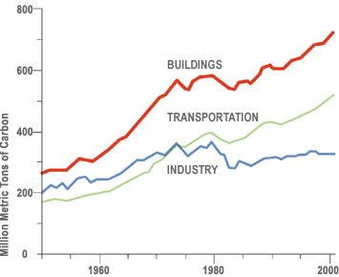
Commercial Buildings
(Source: DOE)
Notes:
Operating buildings in the U.S. contributes the greatest amount of GHG emissions than any other sector. Most of those emissions come from the energy consumed to heat and cool our homes and commercial buildings along with lighting, appliances and equipment. For that reason it makes sense for us to look at ways to reduce energy consumption in buildings.

Slide 8
Methodology
Standardized LCA methodology critical
Increase consistency of LCA
MIT proposes good practices for LCA
Notes:
A standardized LCA methodology is critical in order to increase the consistency of LCA for buildings. The MIT research supports standardization by proposing good practices for conducting LCA on buildings.

Slide 9
Methodology
Transparency of data
Define scope
Identify system boundaries
Define functional unit
Notes:
It is important that LCAs use a comprehensive life cycle perspective and provide transparency with regards to the data, scope, boundaries, functional units and other important LCA parameters.

Slide 10
Goal and Scope
Investigate the role of thermal mass in reducing carbon emissions
Quantify energy advantages of concrete due to thermal mass
Identify potential areas for improvement in life cycle emissions
Notes:
The goal and scope of the MIT work was:
To investigate the role of thermal mass in reducing the carbon emissions of large office buildings
Quantify the inherent energy advantages of concrete due to thermal mass, and to identify potential areas for improvement in the life cycle emissions of commercial buildings.

Slide 11
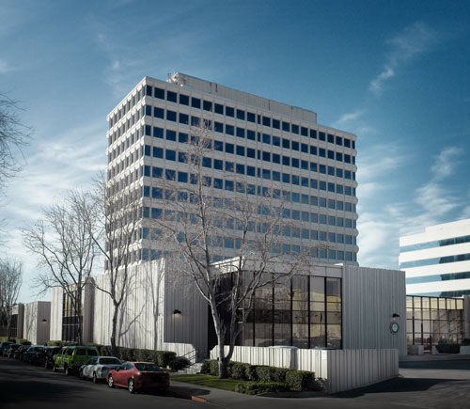
LCA Model
GaBi software to conduct the LCA
EnergyPlus for energy simulations, and.
Notes:
LCA software called GaBi by PE International 2011 was used to conduct the life cycle assessment.
EnergyPlus software developed by US DOE 2010 was used to carry out detailed energy simulations.

Slide 12
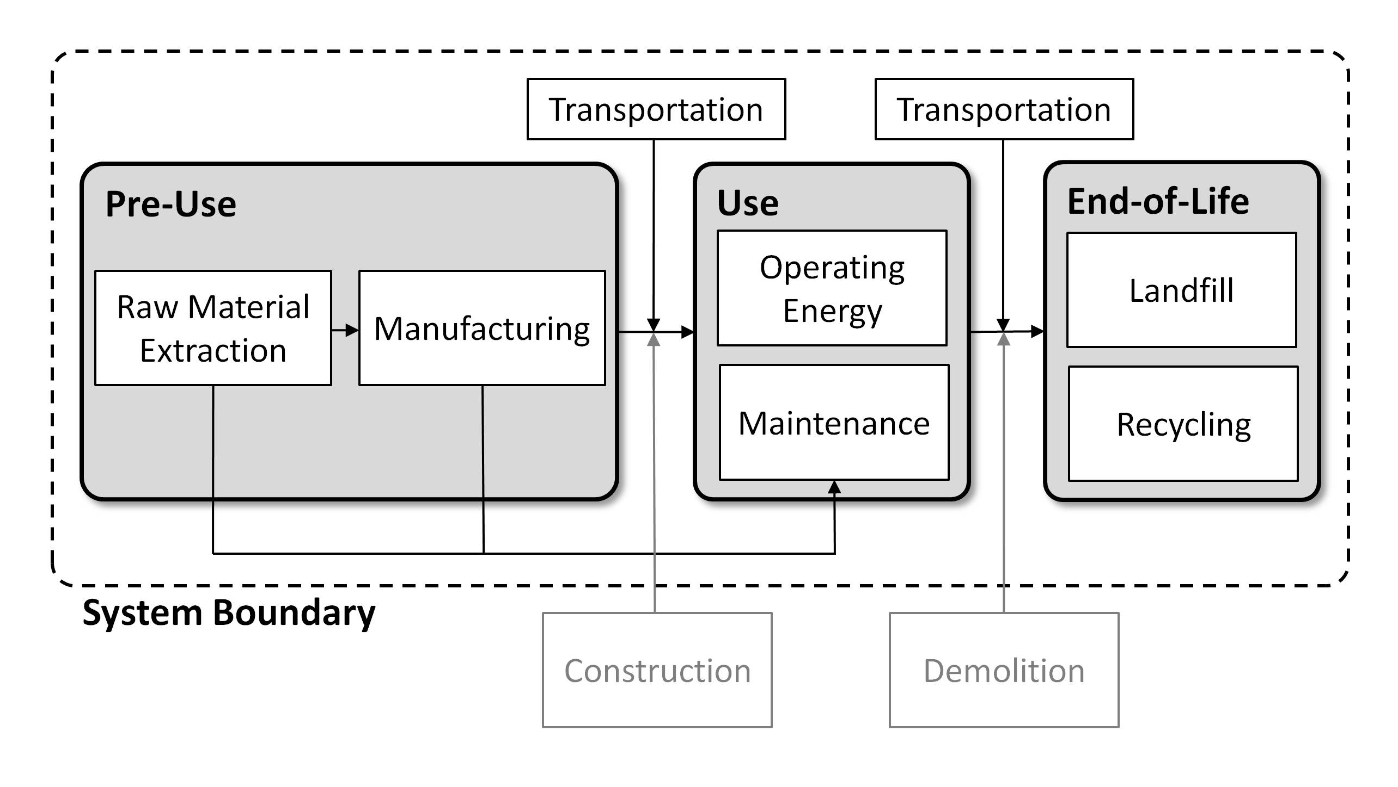
Boundaries
Notes:
Drawing boundaries to include all phases of the building life cycle—materials, construction, use (including operating energy), maintenance, and end of life—allows for an accurate representation of cumulative environmental impacts over the life of a building.

Slide 13
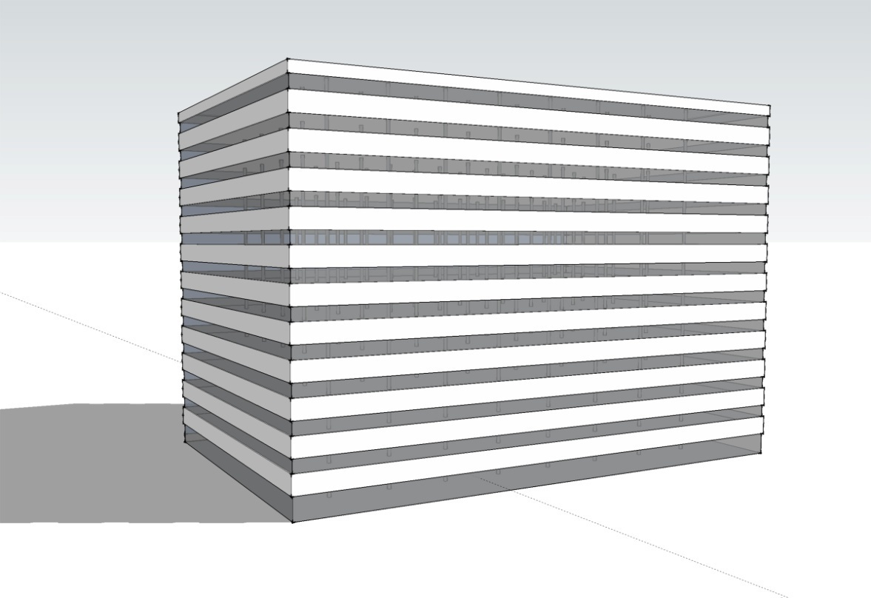


Functional Unit
12 stories
498,590 ft²
Concrete
Steel
Phoenix
Chicago
Notes:
These methodologies were applied to a benchmark 12-story, 498,590 ft2 (46,321 m2) commercial building. The building was analyzed for two climates, Phoenix and Chicago, and for two different structural materials, concrete and steel. The building had 40% glazing and 60% aluminum rain screen panel cladding for both steel and concrete options.

Slide 14
Life Cycle Inventory Data
Databases collected by PE International
U.S. Life Cycle Inventory database (USLCI)
Portland Cement Association (PCA)
World Steel (USLCI 2009)
Manufacturers
Notes:
Part of the available data in the models is from databases collected by PE International, while the rest comes from other sources, such as the U.S. Life Cycle Inventory database (USLCI), the Portland Cement Association (PCA), and World Steel. Manufacturers were contacted when data was unavailable through these sources.

Slide 15
Life Cycle Duration
Operating energy for 60-year life cycle
Global warming potential (CO₂e) quantified for several purposes
  Benchmarking emissions of current construction practices
  Comparing impacts of concrete versus steel
  Understand relative magnitude of relative impacts of different life cycle phases
Notes:
The annual operating energy, determined using the EnergyPlus building energy analysis software, was conducted for a 60-year life cycle. The Global Warming Potential (GWP) was quantified using CO2-equivalents (CO2e) for several purposes, including benchmarking emissions for current construction practices, comparing impacts of concrete versus steel, and understanding the relative magnitude of impacts for different life cycle phases.

Slide 16
Impacts
Notes:
The analysis demonstrated that the greenhouse gas emissions due to operational energy of the benchmark buildings are responsible for 95-96% of life cycle emissions.

Slide 17
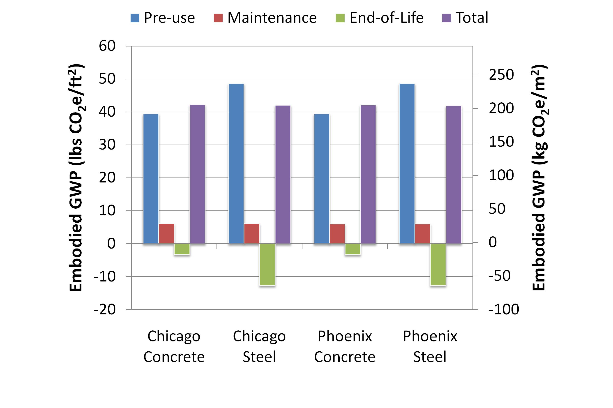
Embodied Emissions
Notes:
The embodied global warming potential (GWP) of the building materials per square foot is shown here. The first bar shows the GWP associated with the pre-use phase. The second bar shows the emissions from maintenance over the use phase, and the third bar shows the end-of-life emissions, associated with landfilling and recycling. The last bar, in purple, shows the total embodied GWP for each building. The concrete and steel buildings both have total embodied emissions of approximately 42 lbs CO2e/ft2 (205 kg CO2e/m2). Steel dominates the GWP of the steel building, and concrete has a larger role in the concrete building. Interior finishes are not included.
It is important to note that because 98% of the structural steel and 70% of the rebar salvaged from the building is assumed to be recycled at the end of life, that recycling adds a credit to the overall life cycle accounting. The large quantity of steel potentially recycled from a steel-framed building means that the end-of-life GWP in the steel building is negative. The end-of-life GWP in the concrete building is also negative, due both to the recycling of reinforcement and concrete.

Slide 18
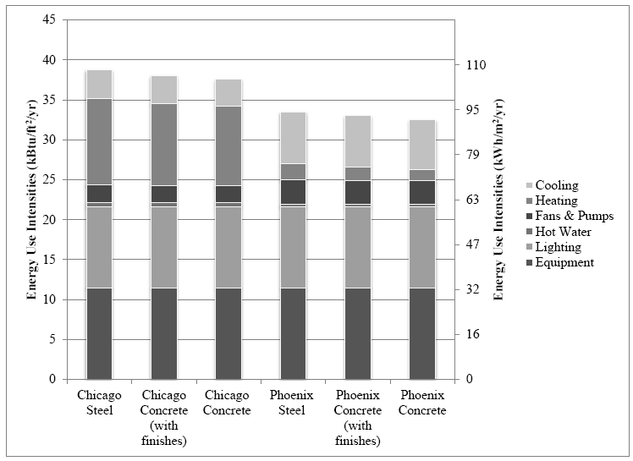
Operational Energy
Notes:
This graph shows energy use of the commercial building in Chicago and Phoenix. The lighting, equipment, and water loads stay the same among all building and climate variations, but the energy used through HVAC, pumps, and fans change based on the climate and source of energy. In the climates of Chicago and Phoenix, a savings in HVAC energy of approximately 7% and 9% respectively can be seen when the exposed concrete building is compared with the steel building, which can be attributed to the higher thermal mass of the concrete building. However, when the whole building energy results are viewed, the savings are diminished to 3% in both Chicago and Phoenix. Having finishes in the building decreases this savings to roughly 2% for both cities because the thermal mass is no longer exposed in this case.

Slide 19
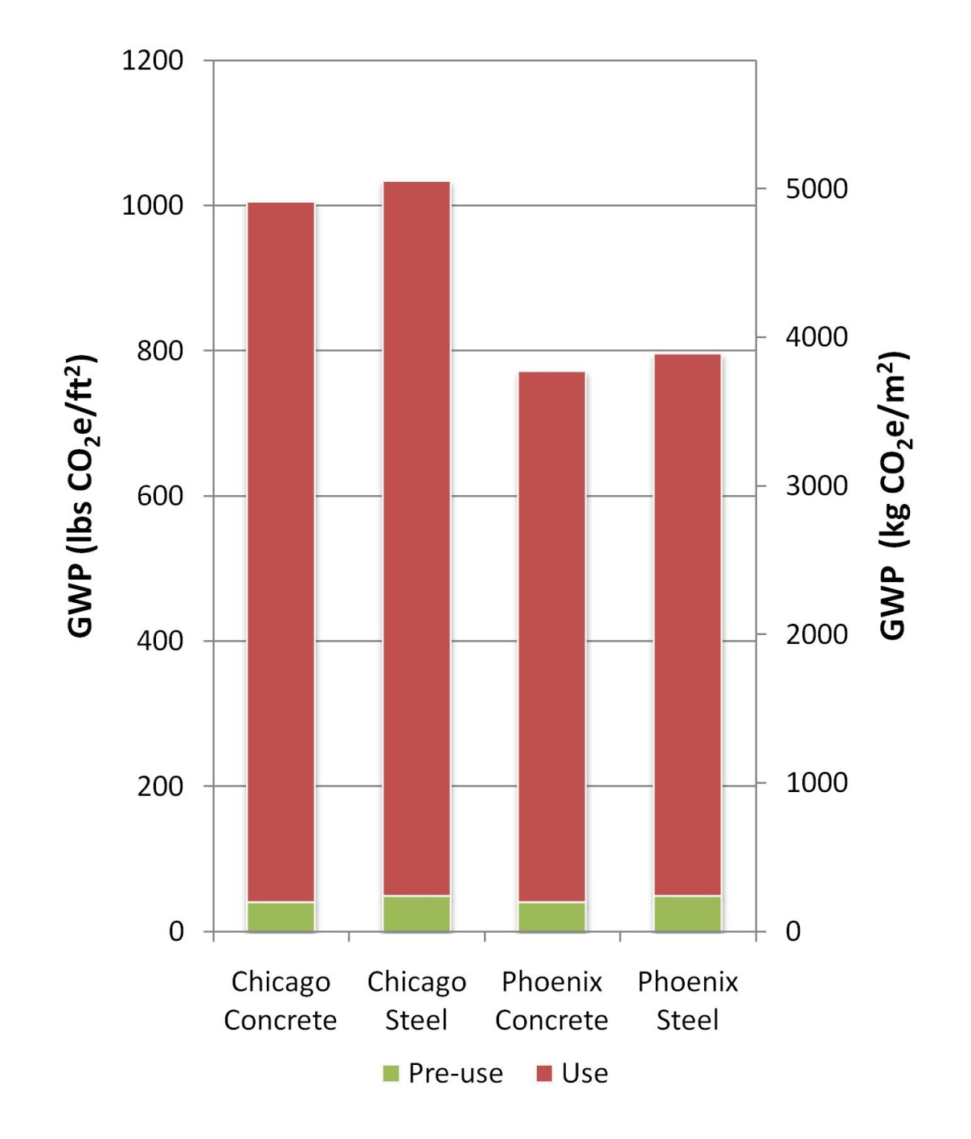
Life Cycle Emissions (60 years)
Notes:
When the GWP for the total life cycle is put together, it becomes clear that the embodied energy composes only a small fraction of the life cycle GWP, as shown in this graph for a typical building lifetime of 60 years. The concrete energy model without finishes was used to calculate total life cycle GWP. Though the steel energy model includes finishes, the embodied portion of the LCA model does not. The two buildings have a difference in GWP of 1.9% in Chicago and 2.0% in Phoenix. If finishes are included in the concrete building, the life cycle GWP is nearly identical to the steel building with finishes.

Slide 20
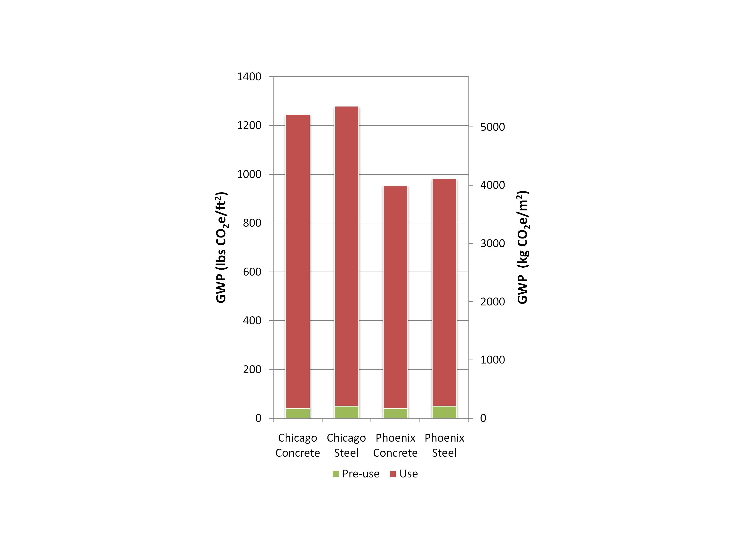
Life Cycle Emissions (75 years)
Notes:
If the GWP is considered for a longer lifespan of 75 years, the overall GWP increases, with the embodied GWP making up a smaller percentage of the total, as shown in this graph. In all cases, the steel and concrete buildings have very similar emissions over the full life cycle, and the choice of structural material does not dramatically influence the total emissions.

Slide 21
Regional Variation
Has significant impact on the life cycle
Assuming 60-year lifetime
  Difference in GWP between Chicago and Phoenix is approximately 23%
  Transportation distances are negligible over the total life cycle
  HVAC have 15% impact in the operational energy use
Notes:
Regional variation has a significant impact on the life cycle of these commercial buildings. Assuming a 60-year lifetime, the difference in CO2e between Chicago and Phoenix is approximately 23% due to the milder climate of Phoenix. This percentage decreases slightly as the lifetime of the building is increased because the pre-use embodied materials remain constant, but it is still significant. Transportation distances are negligible over the total life cycle. HVAC needs that may change among regions have less than a 15% impact in the operational energy use.

Slide 22
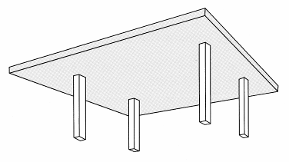
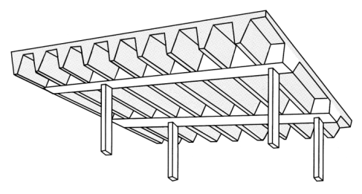
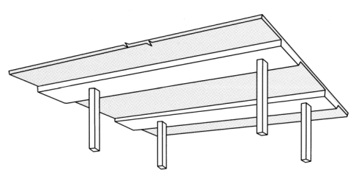
Impact Reductions: Structural System
Recommendations made to reduce GWP
GWP could change slightly if different structural systems were implemented
  Change GWP by a small percentage
  GWP would still be similar to steel frame
Notes:
Several recommendations for reducing life cycle emissions of concrete buildings were presented by MIT.
GWP of either building type could change slightly if different typical structural systems were implemented. For example, designing a one-way slab system in the concrete building, instead of the two-way slab in this example, would vary the concrete building‘s GWP by a few lbs CO2e/ft2 in either direction, but it would still be very similar to the GWP of the steel building.

Slide 23
Impact Reductions: Mix Design
More efficient mix designs
Increased use of SCMs
  Fly ash
  Slag cement
  Silica Fume
Increasing fly ash from 10% to 25%
Decrease pre-use embodied GWP 4.3%
0.18-0.25% reduction of total GWP for 60-year life span
Notes:
GWP of a concrete building can further be reduced by implementing more efficient concrete mix design. One option is to increase the supplementary cementitious material (SCM) substitution in concrete, such as ground granulated blast furnace slag (GGBFS), fly ash, and silica fume. For example, using 25% fly ash content by volume substituted for cement in the concrete would lower the embodied GWP of the concrete by 4.3%. These mixture adjustments would correspond to an overall reduction of 0.18% in the total GWP of a concrete building in Chicago with a 60-year lifespan, and a 0.25% reduction in a similar building in Phoenix.

Slide 24
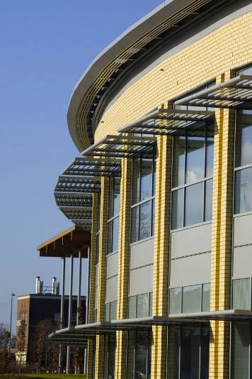
Impact Reductions: Lighting Controls
Strategies studied:
  Façade systems
  Shading systems
  Building massing
Daylighting yielded greatest reductions
71% in perimeter zone lighting by using sensors and dimmers
Notes:
Variations in concrete façade systems, shading systems, and the massing of the buildings are analyzed in EnergyPlus for the effects they have on the overall energy use of the building over its lifetime. The daylighting study yields the greatest reduction in energy use. A control strategy was investigated to modify when the lights will be on. A daylight dimming system consists of a sensor that reads the lighting levels and a controller that responds to the readings by adjusting the electric lighting to meet a specified lighting illumination target. Multiple runs in EnergyPlus demonstrated that the best results occur with two sensors and continuous dimming, which reduces the lighting linearly with the fraction of illumination at the sensor divided by the target illumination. Perimeter zone lighting, in kWh/m2, was reduced by 71%.

Slide 25
Impact Reductions: Passive Solar
High thermal capacity
  Shift energy loads
  Reduce peak demand
  Reduce operational energy
Energy savings of 5-15%
Notes:
Concrete can contribute to reducing operational energy consumption and costs if it is used intelligently. The high thermal capacity of concrete is unique relative to most other building materials. This thermal capacity can be utilized to shift loads, reduce peak demand, and reduce operational energy consumption if it is used as thermal energy storage. Because most floor systems of multi-story commercial buildings are constructed of concrete, a substantial mass of concrete is available for improved thermal storage in most buildings. These energy savings, however, are typically limited to about 5 to 15 percent, as demonstrated by this study.

Slide 26
Impact Reductions: Low-lift Cooling
Pre-cool concrete with embedded chilled water pipes
Use efficient lo-lift chillers
Saves 37-84% over DOE benchmark buildings
Notes:
Additional thermal storage capacity can be used by actively pre-cooling concrete through embedded pipes through which to circulate water. This is called a thermo-active building system (TABS). Chillers designed and operated at low pressure ratios, or low-lift chillers, can have much higher coefficients of performance (COP) than conventional chillers for thermo-active systems (Gayeski et al. 2010). The study by PNNL found that low-lift cooling systems can achieve annual cooling energy savings, including pump, fan and chiller energy consumption, in the range of 37 to 84 percent relative to DOE benchmark buildings depending on the climate and building type (Katipamula et al. 2010).

Slide 27
More Information
Full report available from MIT Concrete Sustainability Hub at web.mit.edu/cshub.
MIT Hub established by
  RMC Research & Education Foundations
  Portland Cement Association
NRMCA providing technical support
  Transfer research into practice
  Visit www.nrmca.org
Notes:
The full report titled Methods, Impacts, and Opportunities in the Concrete Building Life Cycle can be downloaded from the MIT Concrete Sustainability Hub web site at http://web.mit.edu/cshub. The Concrete Sustainability Hub is a research center at MIT that was established by the Ready Mixed Concrete (RMC) Research & Education Foundation and the Portland Cement Association (PCA). NRMCA is providing technical input to the research program and helping transfer the research results into practice.

Slide 28
Online Resources
www.nrmca.org/sustainability
web.mit.edu/cshub
www.greenconcrete.info
www.concretepromotion.org
www.rmc-foundation.org

Slide 29
Thank You

