Slide 1
MIT Year 2 Research Results:
Local Outreach

Slide 2
Outline
What are we Trying to Accomplish?
Who are our Target Audiences?
What Message are we Trying to Convey?
Overview of MIT LCA Year 2 Results
Strategies for Reaching Target Audiences

Slide 3
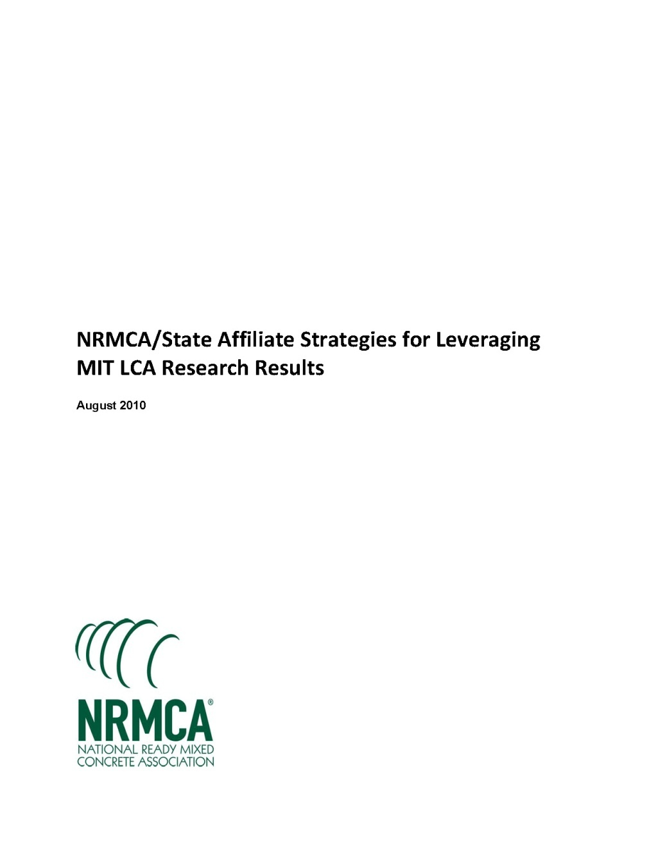
What are we Trying to Accomplish?
Goal: Make concrete sustainable material of choice for government and design professionals

Slide 4

Suggested Strategies
Reaching Decision Makers
  Educate
  Promote
  Advance Technology
  Advocate

Slide 5
Local Outreach
NRMCA provide tools and resources
NRMCA asking for local assistance
  State affiliates
  Members

Slide 6
Who are our Target Audiences?
Primary
  Design professionals
  Government officials
Secondary
  Contractors
  Educators and students
  General Public

Slide 7
What Message are we Trying to Convey?
Concrete is a sustainable material for buildings and pavements over the full life cycle
MIT conducting cutting edge research
New standard for LCA modeling
Quantifies full cradle-to-grave life-cycle environmental and economic costs
  Pavements
  Buildings (residential and commercial)
Unprecedented focus on “use phase”

Slide 8
The Main Message
MIT is the leader in LCA
The “Use Phase” dominates life cycle impacts

Slide 9
MIT LCA Research Summary

Slide 10


MIT Concrete Sustainability Hub
$10 million investment over next 5 years
Funded equally by RMCREF & PCA
NRMCA providing technical support and guidance
NRMCA and state associations can play a critical role in the technology transfer

Slide 11
MIT CSH Research Platforms
Concrete Science
Scientific breakthroughs toward reducing the CO₂ footprint of cement and concrete
Econometrics
Impact on economy:
- System dynamics
- Effect on policy (e.g. Carbon Tax
Building Technology
The CO₂ footprint of concrete structures
- Material Flows
- Life Cycle Assessment

Slide 12
MIT Year 2 Research Summaries
LCA of Commercial Buildings
LCA of Residential Buildings
LCA of Concrete Pavements
LCCA: Effects of Inflation and Volatility on Construction Alternatives

Slide 13
MIT Research: Life Cycle Assessment of Commercial Buildings
Notes:
Life cycle assessment (LCA) offers a comprehensive methodology for evaluating the environmental impacts
of buildings. Recent research at the Massachusetts Institute of Technology (MIT) explored and advanced key areas relevant to the field of LCA including methodology, benchmarking and impact reduction.

Slide 14
Methodology
Standardized LCA methodology critical
Increase consistency of LCA
MIT proposes good practices for LCA
Notes:
A standardized LCA methodology is critical in order to increase the consistency of LCA for buildings. The MIT research supports standardization by proposing good practices for conducting LCA on buildings.

Slide 15
Methodology
Transparency of data
Define scope
Identify system boundaries
Define functional unit
Notes:
It is important that LCAs use a comprehensive life cycle perspective and provide transparency with regards to the data, scope, boundaries, functional units and other important LCA parameters.

Slide 16
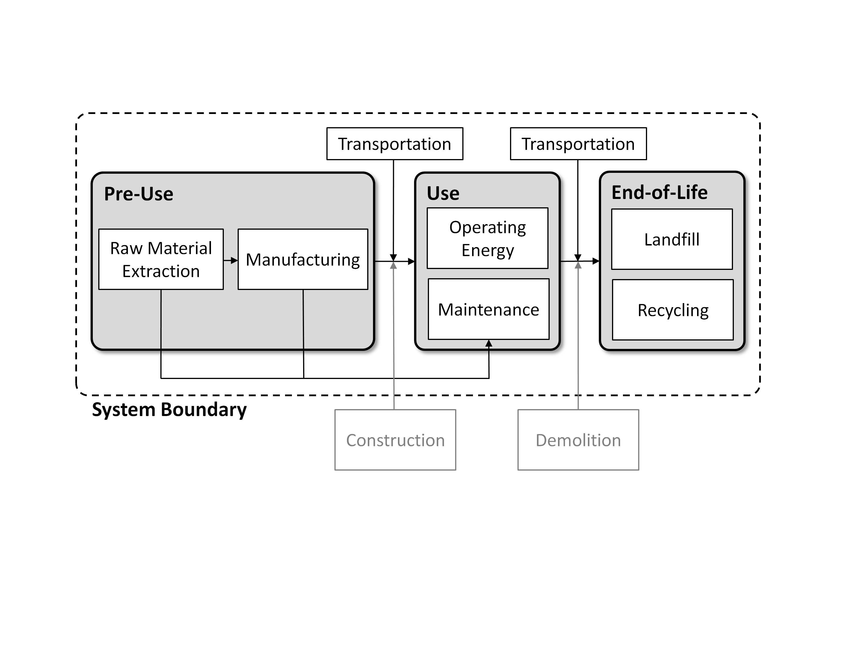
Life Cycle Perspective
Notes:
Drawing boundaries to include all phases of the building life cycle—materials, construction, use (including operating energy), maintenance, and end of life—allows for an accurate representation of cumulative environmental impacts over the life of a building.

Slide 17
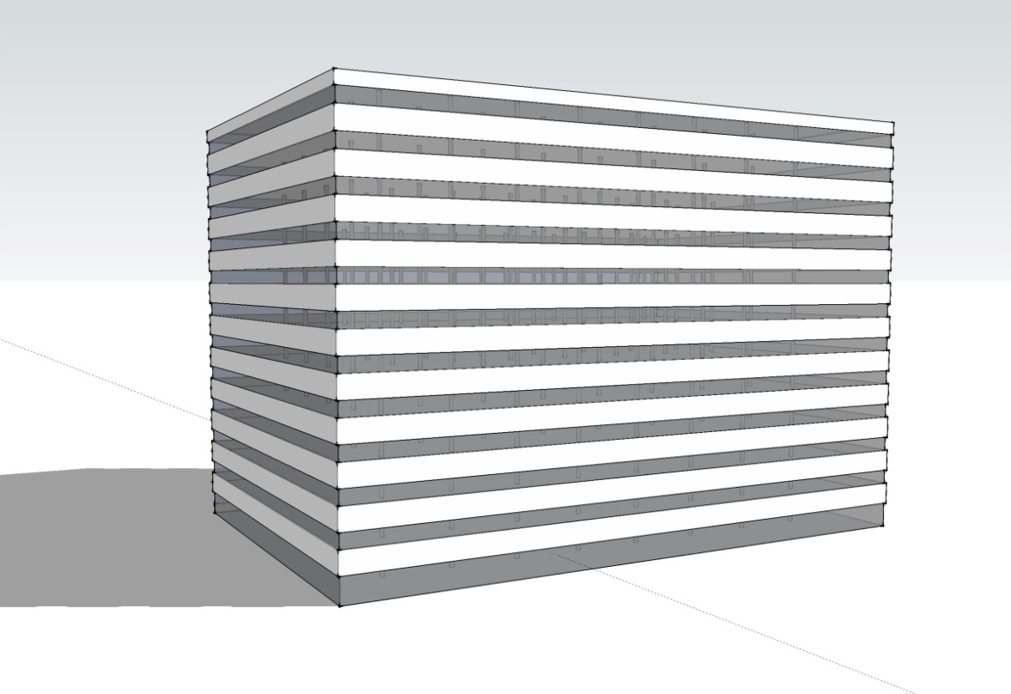


Benchmark Building
12 stories
498,590 ft²
Concrete
Steel
Phoenix
Chicago
Notes:
These methodologies were applied to a benchmark 12-story, 498,590 ft2 (46,321 m2) commercial building. The building was analyzed for two climates, Phoenix and Chicago, and for two different structural materials, concrete and steel.

Slide 18
Benchmark Analysis
Operating energy for 60-year life cycle
Global warming potential (CO₂e) quantified for several purposes
  Benchmarking emissions of current construction practices
  Comparing impacts of concrete versus steel
  Understand relative magnitude of relative impacts of different life cycle phases
Notes:
The annual operating energy, determined using the EnergyPlus building energy analysis software, was conducted for a 60-year life cycle. The Global Warming Potential (GWP) was quantified using CO2-equivalents (CO2e) for several purposes, including benchmarking emissions for current construction practices, comparing impacts of concrete versus steel, and understanding the relative magnitude of impacts for different life cycle phases.

Slide 19
Impacts
Notes:
The analysis demonstrated that the greenhouse gas emissions due to operational energy of the benchmark buildings are responsible for 95-96% of life cycle emissions.

Slide 20
Embodied Emissions
Concrete and steel
  Have similar embodied emissions
  42 lbs CO2e/ft2 (205 kg CO2e/m2)
Embodied emissions include
  Pre-use
  Maintenance
  End-of-life
Notes:
Compared to the steel structure, the concrete building has approximately the same embodied emissions (pre-use, maintenance and end-of-life phases) of 42 lbs CO2e/ft2 (205 kg CO2e/m2)

Slide 21
Thermal Mass Benefits
Concrete provides HVAC savings of 7-9% compared to steel frame
Accounts for 2% savings in annual operating emissions
Notes:
Thermal mass of an exposed concrete frame can provide HVAC savings of 7-9% compared to a steel frame. This accounts for 2% savings in annual operating emissions

Slide 22
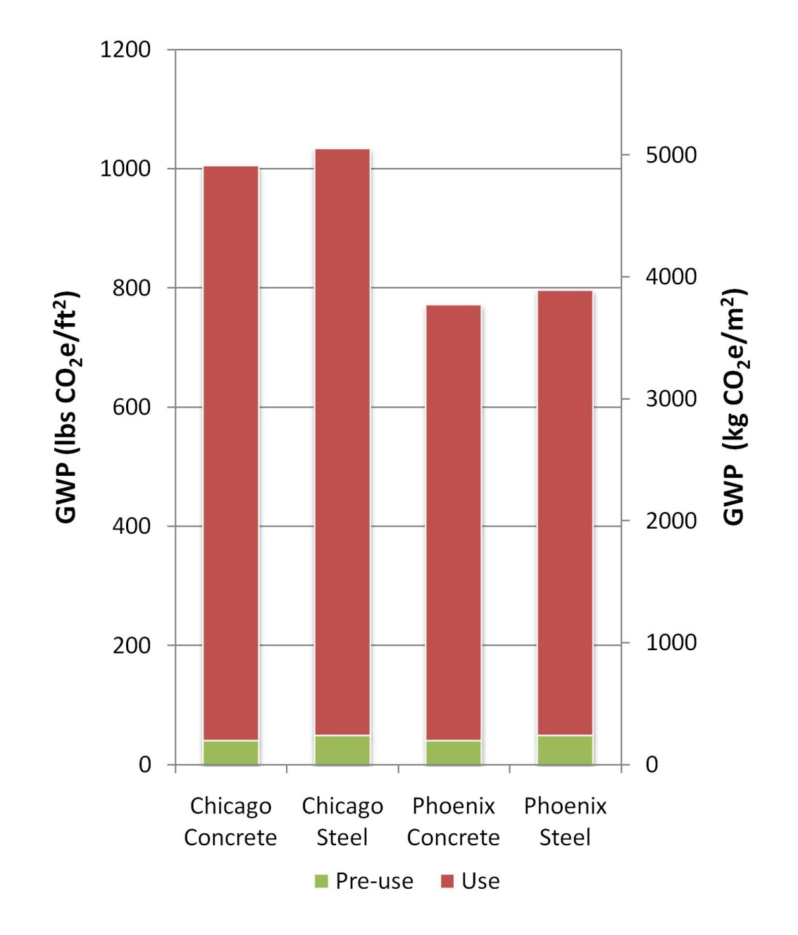
Operational Emissions
Notes:
Over a lifetime of 60 years, the CO2e emissions of the concrete building were slightly lower than the steel alternative. The steel and concrete buildings have very similar emissions over the full life cycle, and the choice of structural material does not dramatically influence the total emissions.

Slide 23
Impact Reductions
Increasing SCM (such as fly ash) from 10% to 25%
Can decrease pre-use GWP by 4.3%
Lighting control and low-lift cooling
Can decrease the operating energy for concrete buildings
Notes:
Several recommendations for reducing life cycle emissions of concrete buildings were presented by MIT.
Increasing SCM substitution (such as fly ash) in the concrete building from 10% to 25% can decrease pre-use
GWP by 4.3%
Lighting control and low-lift cooling can decrease the operating energy requirements for concrete buildings. Low-lift cooling takes advantage of the high heat capacity of concrete and is effective when building cooling loads are reduced through control of internal and solar heat loads.

Slide 24
More Information
Full report available from MIT Concrete Sustainability Hub at web.mit.edu/cshub.
MIT Hub established by
  RMC Research & Education Foundations
  Portland Cement Association
NRMCA providing technical support
  Transfer research into practice
  Visit www.nrmca.org
Notes:
The full report titled Methods, Impacts, and Opportunities in the Concrete Building Life Cycle can be downloaded from the MIT Concrete Sustainability Hub web site at http://web.mit.edu/ cshub. The Concrete Sustainability Hub is a research center at MIT that was established by the Ready Mixed Concrete (RMC) Research & Education Foundation and the Portland Cement Association (PCA). NRMCA is providing technical input to the research program and helping transfer the research results into practice.

Slide 25
MIT Research: Life Cycle Assessment of Residential Buildings
Notes:
Life cycle assessment (LCA) offers a comprehensive methodology for evaluating the environmental impacts
of buildings. Recent research at the Massachusetts Institute of Technology (MIT) explored and advanced key areas relevant to the field of LCA including methodology, benchmarking and impact reduction.

Slide 26
Methodology
Standardized LCA methodology critical
Increase consistency of LCA
MIT proposes good practices for LCA
Notes:
A standardized LCA methodology is critical in order to increase the consistency of LCA for buildings. The MIT research supports standardization by proposing good practices for conducting LCA on buildings.

Slide 27
Methodology
Transparency of data
Define scope
Identify system boundaries
Define functional unit
Notes:
It is important that LCAs use a comprehensive life cycle perspective and provide transparency with regards to the data, scope, boundaries, functional units and other important LCA parameters.

Slide 28
Life Cycle Perspective
Notes:
Drawing boundaries to include all phases of the building life cycle—materials, construction, use (including operating energy), maintenance, and end of life—allows for an accurate representation of cumulative environmental impacts over the life of a building.

Slide 29
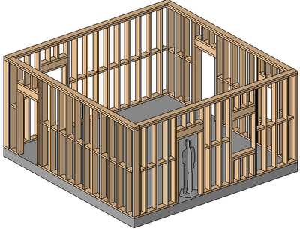
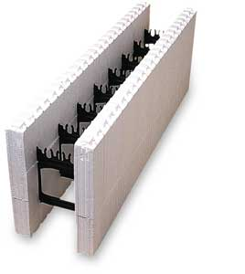
Structural Systems Considered
Insulated Concrete Forms (ICF)
Traditional Wood Framing
Notes:
The general methodology was applied to benchmark structures used in residential building applications using Insulated Concrete Form (ICF) construction consisting of concrete walls encased in expanded polystyrene (EPS) insulation, and typical light-frame wood construction.

Slide 30
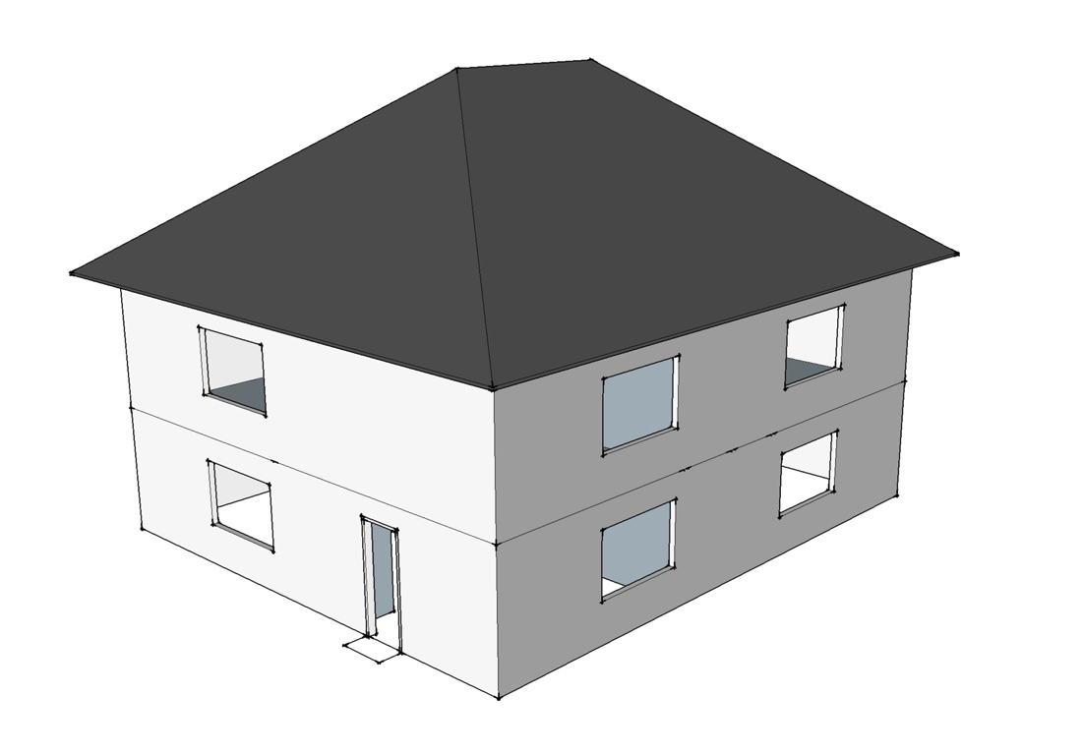
Benchmark Single Family Building
2 stories
2,400 ft²
ICF
Wood
Phoenix
Chicago
Notes:
The first study model considered a two-story, 2400 ft2 (223 m2) single-family building.
The LCAs were carried out for two different cities in the United States, modeling regional and climatic differences: Chicago, representing a cold climate, and Phoenix, representing a hot, dry climate.
To model representative houses for the two different climate regions, the Phoenix house is supported by a slab-on-grade (SOG) and the Chicago house has a basement wall foundation. The only major difference between the light-frame wood and ICF house is the exterior walls.

Slide 31
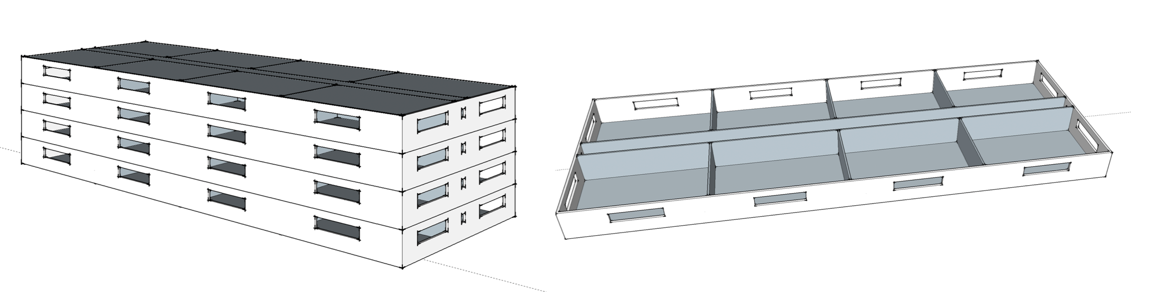
Benchmark Single Family Building
4 stories
33,763 ft²
ICF
Wood
Phoenix
Chicago
Notes:
Then, a 4-story multi-family apartment building with a total square footage of 33,763 ft2 (3,137 m2) was modeled. Again, the LCAs were carried out for two different cities Chicago and Phoenix.

Slide 32

Benchmark Analysis
60
YEAR
Resources
Water
Global Warming
Potential
Ozone Depletion
Acidification
Eutrophication
Smog Formation
Human Toxicity
Eco Toxicity
Waste
Land Use
Notes:
The annual operating energy, determined using the EnergyPlus building energy analysis software, was conducted for a 60-year life cycle. Benchmark single-family houses are designed and modeled based on the Building America House Simulation Protocol (BAHSP).
The resulting Global Warming Potential (GWP) was then quantified using CO2-equivalents (CO2e) for a number of purposes, including benchmarking emissions for current practices, comparing concrete with wood, and understanding the relative importance of different phases of the life cycle. Global warming potential (CO₂e) quantified for several purposes
Benchmarking emissions of current construction practices
Comparing impacts of concrete versus wood
Understand relative magnitude of relative impacts of different life cycle phases
(Global-warming potential (GWP) is a relative measure of how much heat a greenhouse gas traps in the atmosphere expressed as a factor of carbon dioxide.)

Slide 33
Impacts
Concrete homes have higher embodied GWP in the pre-use phase
Only accounts for 2-12% of life cycle GWP
For cold climate energy savings ICF house
23% of total operating energy
Notes:
Concrete homes have higher embodied GWP in the pre-use phase-but this phase accounts for only about 2-12% of overall GWP for the life of the home.
For a cold climate, such as Chicago, the energy savings of an ICF house built from average to tight levels of air infiltration saves 23% of total operating energy.

Slide 34
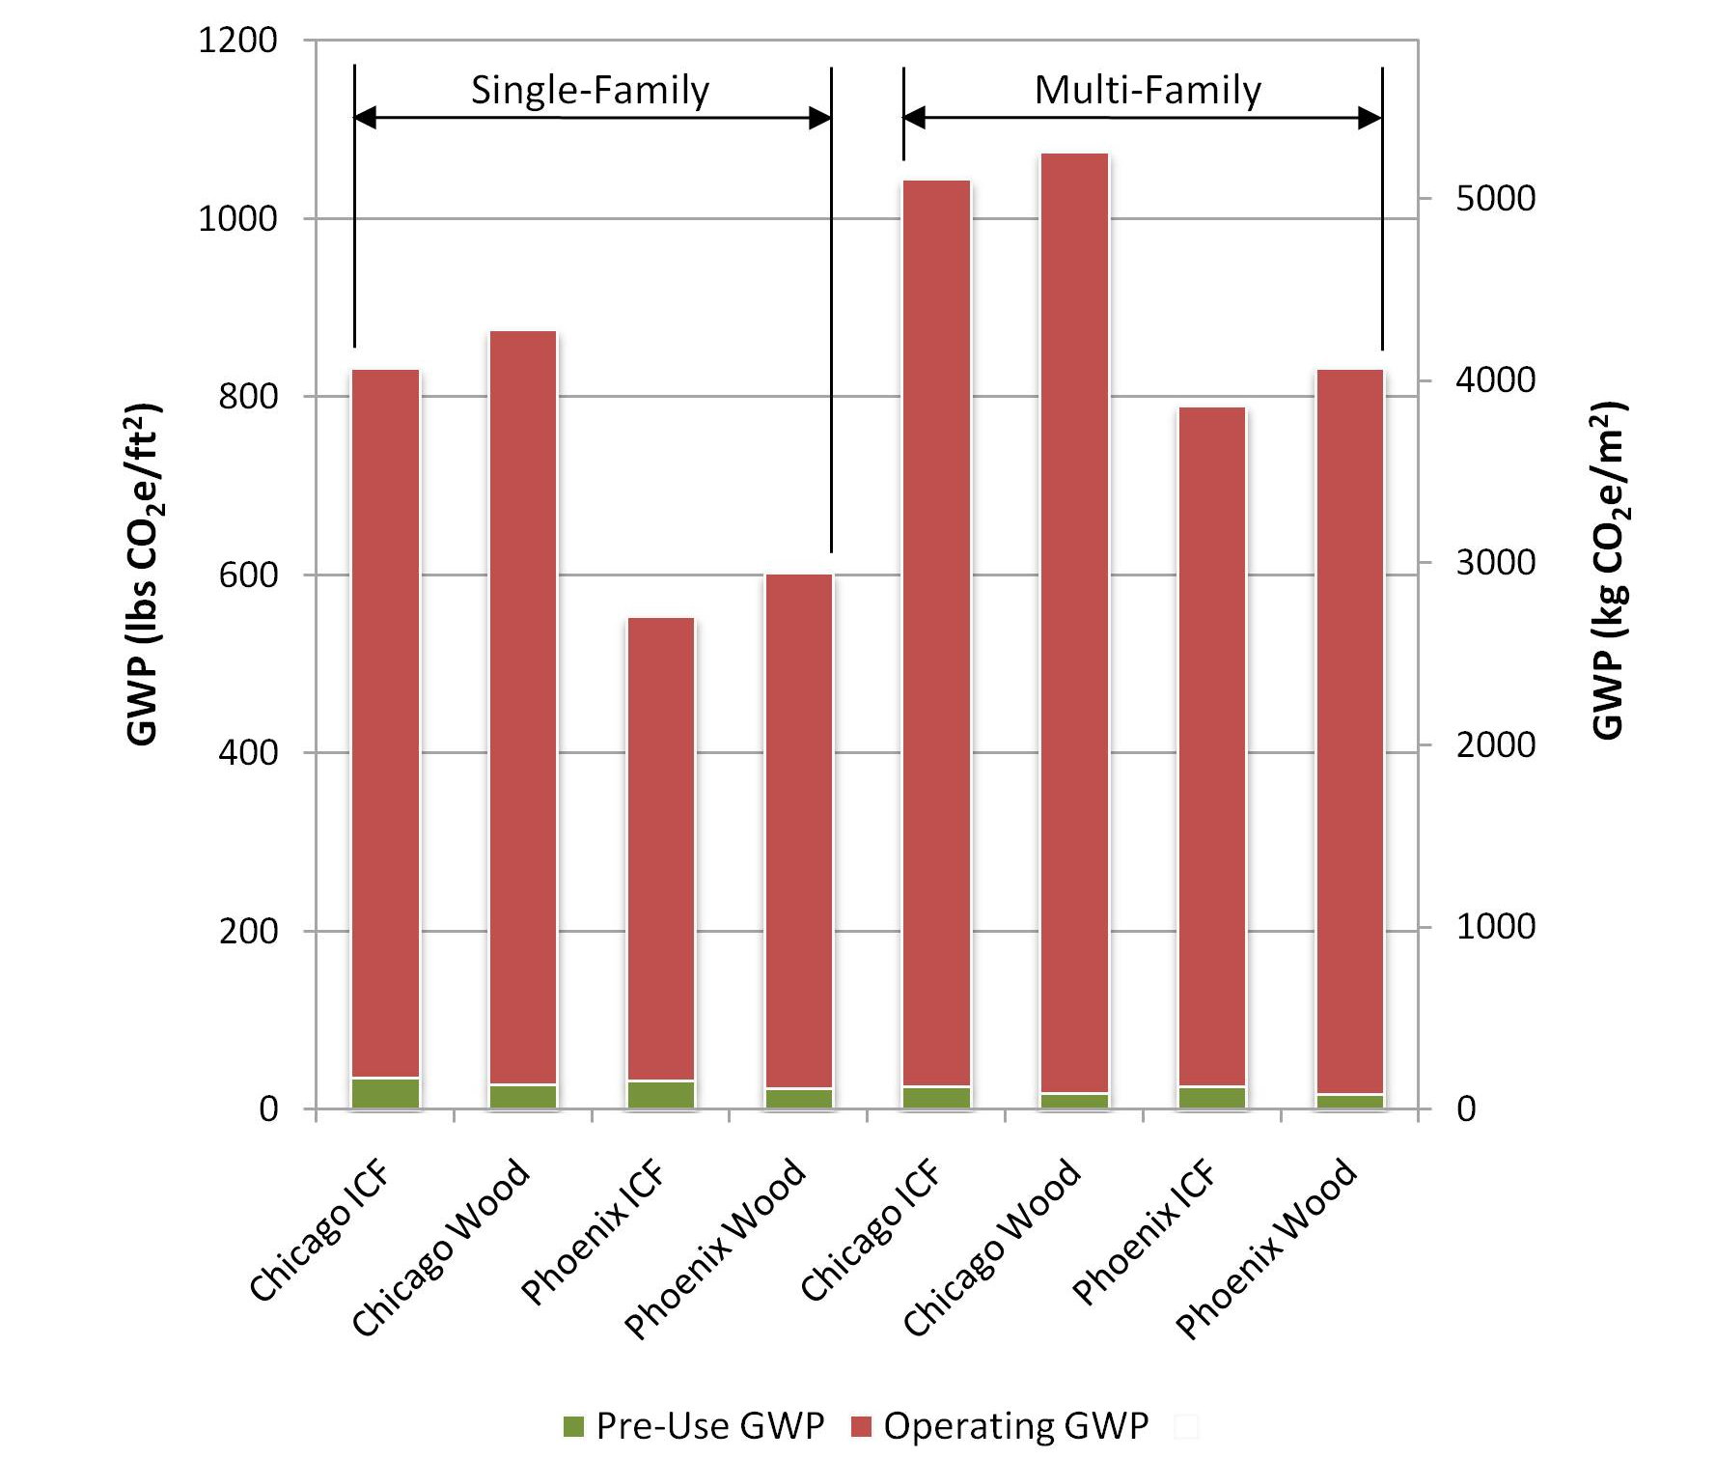
Impacts
Notes:
Over a 60-year life cycle, the lower (5%-8% for single family, 4.4%-6.2% for multifamily) operating GWP outweighs the initially equal or higher embodied GWP for ICF buildings. The total life cycle GWP is equal to, or lower than, alternate designs in wood.

Slide 35
Impact Reductions
Reducing ICF core from 6 in. to a 4 in.
Cost effective and reduces emissions
Thicker insulation, increasing tightness and using thinner concrete
Reduces emissions
At Lower than current market pricing of carbon
Increasing SCMfrom 10% to 50%
Can decrease pre-use GWP by 12-14%
Notes:
Moving from a 6 in (15.2 cm) to a 4 in (10.2 cm) core is both cost effective and reduces emissions over the lifetime of the wall assembly, and it should be considered in regions of the country where a 4 in (10.2 cm) core meets structural requirements.
By producing ICF insulation blocks with different panel thicknesses, increasing the tightness of houses, and making a thinner ICF wall, greenhouse gas emissions can be reduced at prices lower than the current market pricing of carbon.
Increasing SCM substitution from 10% to 50% in the ICF house reduces the pre-use GWP by 12% to 14%. Similar results are found for the multifamily study.

Slide 36
Life Cycle Cost
Compared to light-frame wood, ICF
$2.36-$4.09/ft2 ($25-44/m2) of wall area higher in Chicago
-$0.08 to $4.15/ft2 (-$1 to $45/m2) of wall area in Phoenix
Over the total life cycle cost, however, ICF construction increases the price of a house by less than 5%.
Notes:
A major advancement of the MIT research was the incorporation of a cost-effective analysis to determine whether or not a given construction strategy made economic sense. The report found ICF construction is a more expensive construction alternative than light-frame wood construction but offers lower energy costs in the use phase. Accounting for a range of construction costs and discount rates, the relative life cycle costs for ICF construction (compared to light-frame wood) is $2.36-$4.09/ft2 ($25-44/m2) of wall area higher in Chicago and -$0.08 to $4.15/ft2 (-$1 to $45/m2) of wall area in Phoenix. Over the total life cycle cost, however, ICF construction increases the price of a house by less than 5%.

Slide 37
More Information
Full report available from MIT Concrete Sustainability Hub at web.mit.edu/cshub.
MIT Hub established by
  RMC Research & Education Foundations
  Portland Cement Association
NRMCA providing technical support
  Transfer research into practice
  Visit www.nrmca.org
Notes:
The full report titled Methods, Impacts, and Opportunities in the Concrete Building Life Cycle can be downloaded from the MIT Concrete Sustainability Hub Web site at http://web.mit.edu/ cshub. The Concrete Sustainability Hub is a research center at MIT that was established by the Ready Mixed Concrete (RMC) Research & Education Foundation and the Portland Cement Association (PCA). NRMCA is providing technical input to the research program and helping transfer the research results into practice.

Slide 38
MIT Research: Life Cycle Assessment of Concrete Pavements
Notes:
Life cycle assessment (LCA) offers a comprehensive approach to evaluating and improving the environmental impacts of concrete pavements. Recent research at the Massachusetts Institute of Technology (MIT) explores and advances key areas relevant to the field of pavement LCA: methodology, benchmarking and impact reduction.

Slide 39
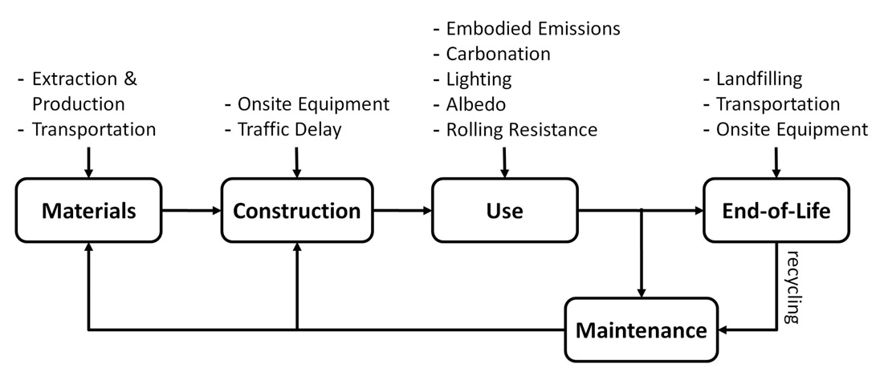
Methodology
Suggested System Boundaries
Notes:
Methodology
The US roadway system is a complex web of approximately 2.6 million miles of public roadways upon which approximately three trillion vehicle miles are traveled every year. US EPA indicates that road transport contributes the most green house gas (GHG) emissions of any transport mode. Additionally, construction and maintenance of these roadways consume energy and resources. For these reasons, there is a growing desire to identify opportunities to reduce GHG emissions during construction, operation and maintenance of roadways. Researchers employed standardized LCA methodology to assess the environmental impact of concrete pavements to encompass the entire life cycle―materials, construction, use, maintenance, and end-of-life. This allowed researchers to quantify cumulative environmental impacts and provide ways to reduce GHG emissions.

Slide 40
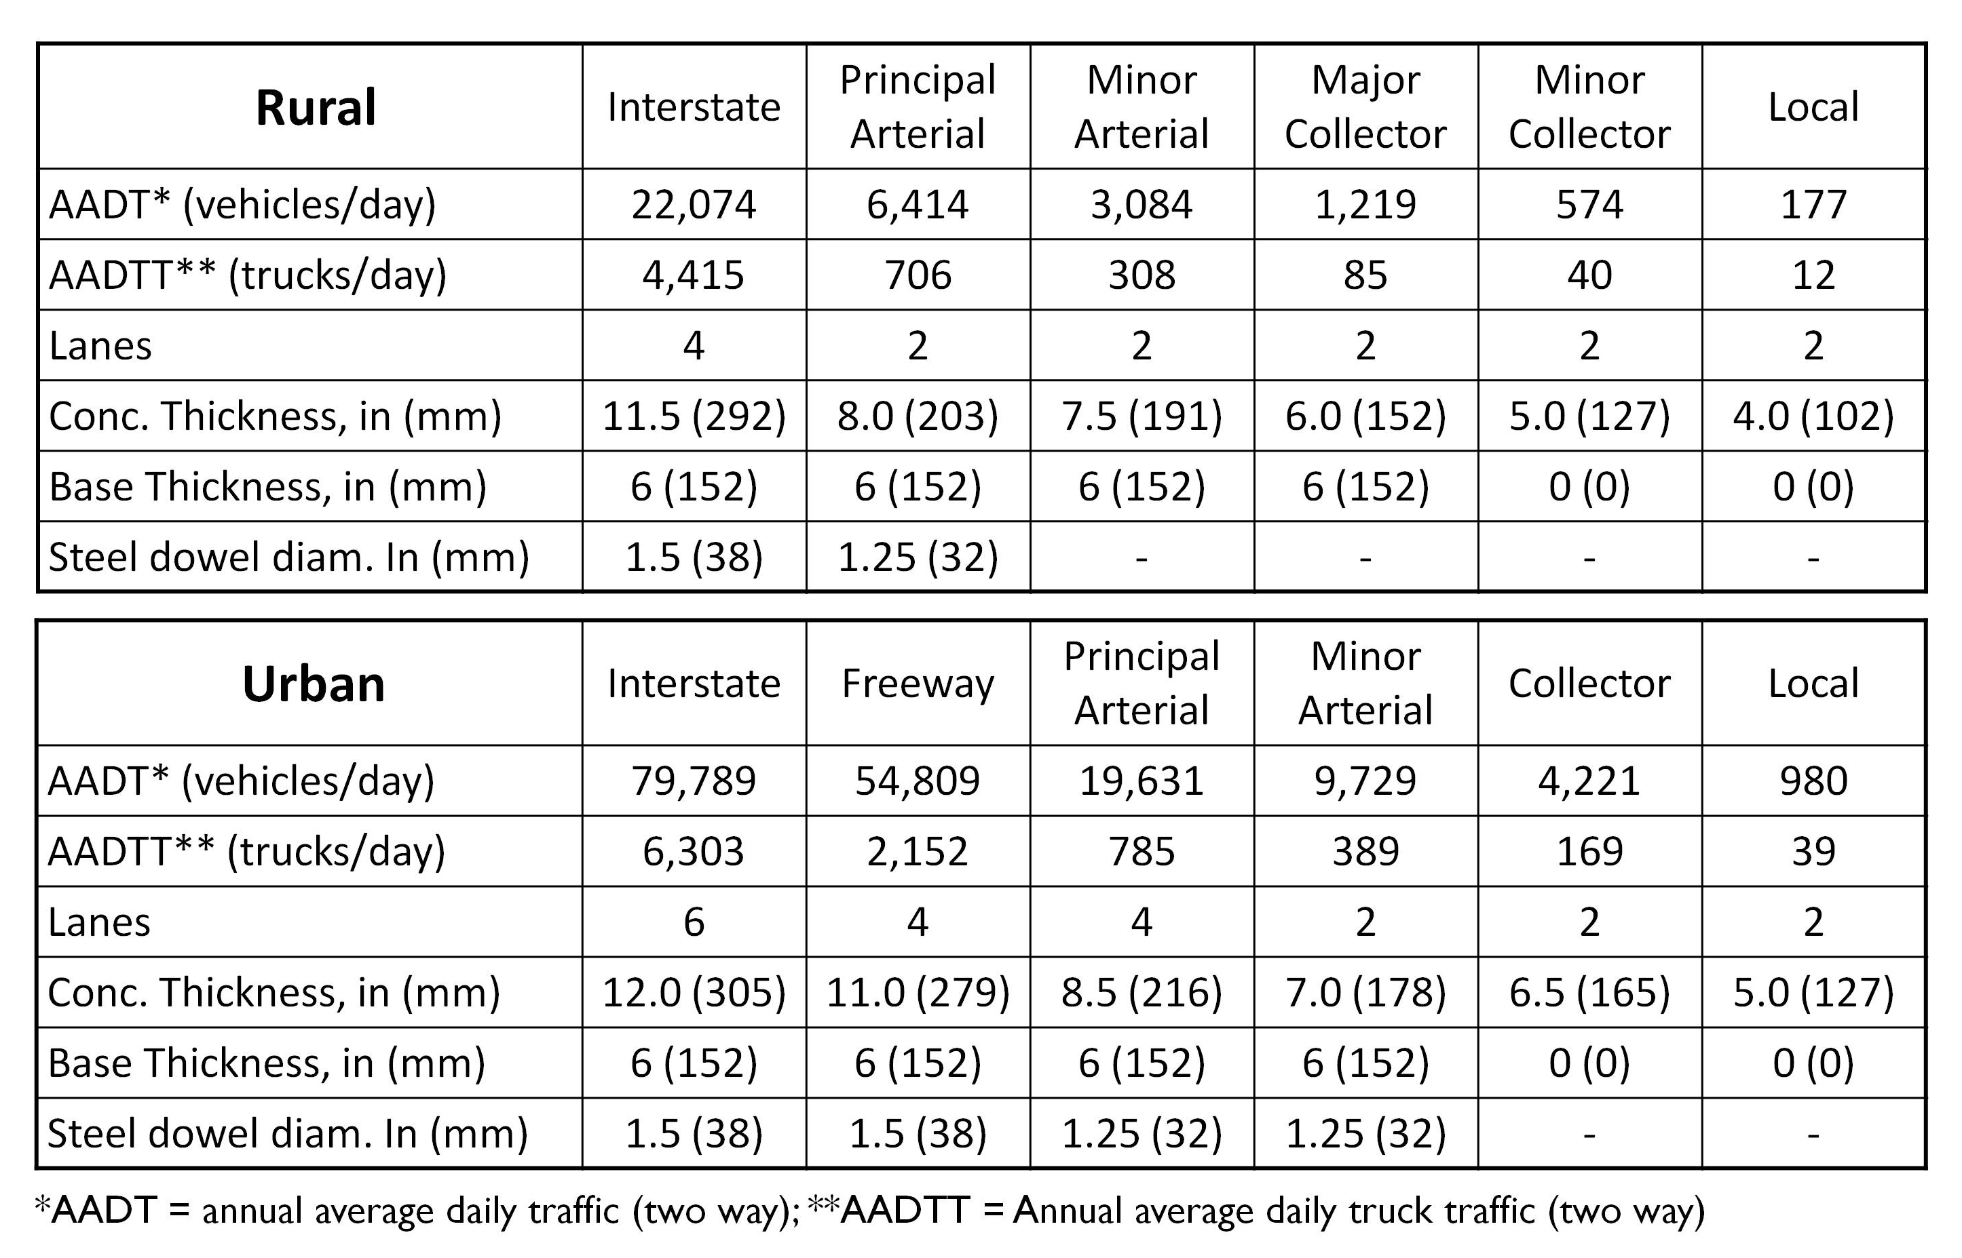
Benchmarking
Notes:
Benchmarking
The LCA methodology was applied to benchmark twelve pavement designs based on FHWA (Federal Highway Administration) roadway classifications ranging from rural local roads to urban interstates. The designs were developed using 1993 AASHTO Method for the Design of Pavement Structures to capture the current state of practice used by most government agencies. Global Warming Potential (GWP), measured in terms of carbon dioxide equivalents (CO2e), were determined for each life cycle phase for the 12 pavement designs to quantify the relative importance of each life cycle phase and identify specific strategies to reduce GWP of concrete pavements.

Slide 41
Impacts
GWP of concrete pavements ranged from:
  600 tons CO₂e/mi (340 Mg CO₂e/km) on rural local roads
  11,000 tons CO₂e/mi (6,300 Mg CO₂e/km) on urban interstates.
Notes:
Impacts
Results from the research indicate:
-GWP of concrete pavements ranged from 600 tons CO2e/mi (340 Mg CO2e/km) on rural local roads to 11,000 tons CO2e/mi (6,300 Mg CO2e/km) on urban interstates.

Slide 42
Impacts
GHG emissions from cement production are the largest contributor
  45% for urban interstates
  72% for rural local roads
Notes:
-GHG emissions from cement production are the largest contributor―45% for urban interstates to 72% for rural local roads

Slide 43
Impacts
For 9 of 12 pavement designs
Second largest contributor to GWP is fuel consumed from roughness
Notes:
- For 9 of 12 pavement designs, the second largest contributor to GWP is fuel consumed from roughness.

Slide 44
Impact Reduction
Increasing fly ash from 10% to 30% GWP could be reduced by:
  15% for urban interstates
  36% for local roads
Increasing albedo reduces urban heat island
  43% reduction in GWP
Notes:
There are a number of potential GHG emissions reduction strategies for concrete pavements that were explored by MIT, and LCA provides guidance for future environmental improvements. Notable results regarding potential reduction strategies include:
- GWP could be reduced by 15% for urban interstates to 36% for local roads by increasing the percentage of fly ash in concrete from 10% to 30%
-Increasing the albedo of concrete reduces the urban heat island effect resulting in 43% reduction in GWP

Slide 45
Impact Reduction
Carbonation through crushing and stockpiling concrete for one year
  sequestered 28% of initial CO₂ released
Reducing roughness through extra pavement rehabilitations
  Reduces GWP by 13% for urban interstates
  Increases GWP for rural local roads by 10%
Notes:
-Carbonation through crushing and stockpiling concrete for one year sequestered 28% of initial CO2 released.
-Reducing roughness through extra pavement rehabilitations reduces GWP by 13% for urban interstates but increases GWP for rural local roads by 10%.

Slide 46
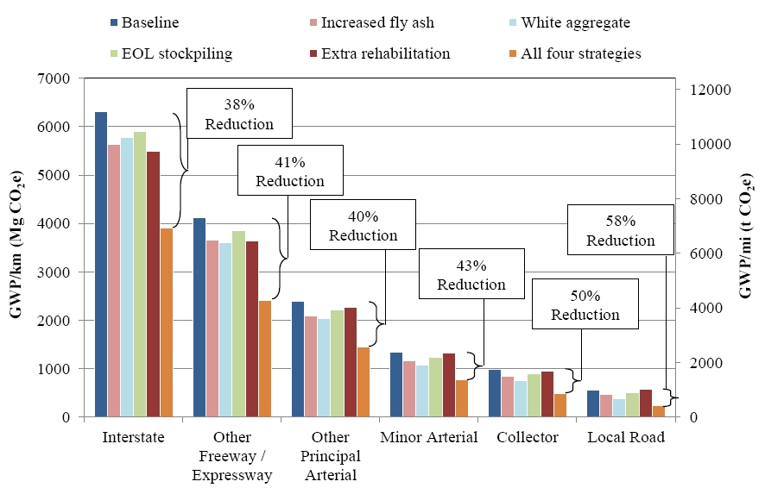
Impact Reduction
Notes:
Implementing all four strategies could decrease GWP from 38% for urban interstates to 58% for urban local roads

Slide 47
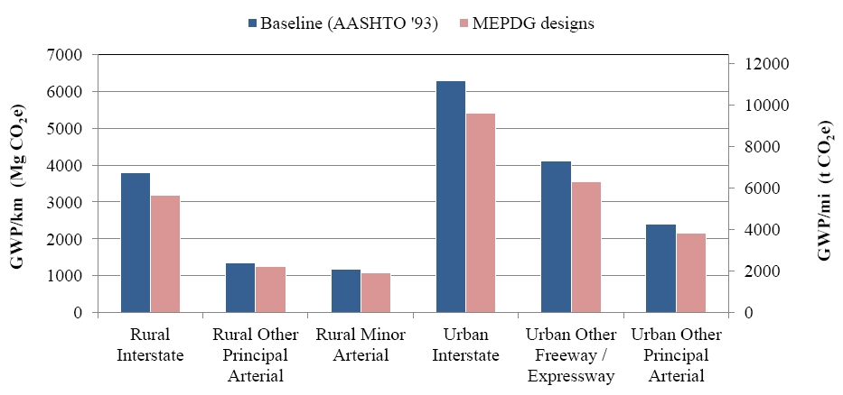
Impact Reduction
Notes:
Another way to decrease GWP is to provide more cost effective pavement designs using state-of-the-art design methodologies. For example, utilizing AASHTO Mechanistic Empirical Pavement Design Guide (MEPDG) in lieu of 1993 AASHTO Design Guide could reduce GWP by up to 17% for rural interstates.

Slide 48
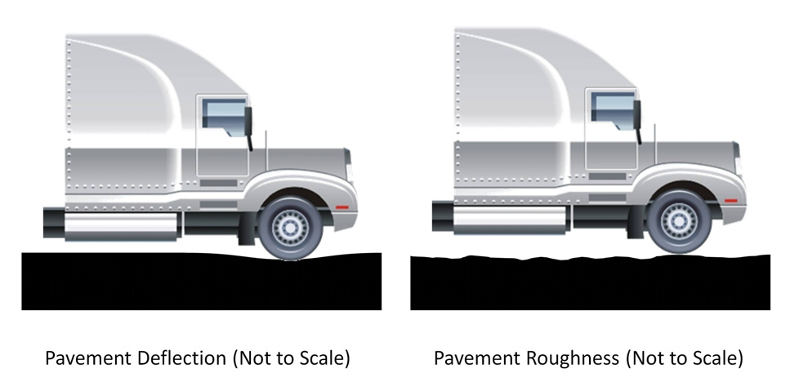
Pavement Vehicle Interaction
Mechanistic model for pavement deflection
Asphalt pavement 1.6 times thicker than an equivalent concrete pavement to achieve the same fuel consumption.
Notes:
Pavement-vehicle interaction (PVI) describes the effect of pavement properties on vehicle fuel consumption. The effect of PVI on fuel consumption over a full life cycle can be significant. Roughness and deflection are the main contributors to higher fuel consumption
MIT developed a mechanistic model to draw a relationship between pavement deflection and fuel consumption. It validated the model by comparing results to existing field data. The mechanistic model calculates that an asphalt pavement would need to be 1.6 times thicker than an equivalent concrete pavement to achieve the same fuel consumption.

Slide 49
More Information
Full report available from MIT Concrete Sustainability Hub at web.mit.edu/cshub
MIT Hub established by
  RMC Research & Education Foundations
  Portland Cement Association
NRMCA providing technical support
  Transfer research into practice
  Visit www.nrmca.org
Notes:
The full report titled Methods, Impacts, and Opportunities in the Concrete Pavement Life Cycle can be downloaded from the MIT Concrete Sustainability Hub web site at http://web.mit.edu/cshub. The Concrete Sustainability Hub is a research center at MIT that was established by the Ready Mixed Concrete (RMC) Research & Education Foundation and the Portland Cement Association (PCA). NRMCA is providing technical input to the research program and helping transfer the research results into practice.

Slide 50
MIT Research: Effects of Inflation and Volatility on Construction Alternatives
Notes:
Life-Cycle Cost Analysis (LCCA) is an analytical tool that provides a cost comparison between two or more competing design alternatives that provide equivalent benefits for the project being analyzed.
Most LCCAs assume all construction materials have constant real prices. This assumption is the same as assuming that all commodity prices go up with general inflation. When prices rise more (or less) than expected, the projects with larger future costs will be unfairly advantaged (or penalized).

Slide 51
Life-Cycle Cost Analysis: The Basics
Initial Construction Costs
Net
Present
Value, $
Rehabilitation Activity Costs
Maintenance Activity Costs
Discount
to
Present
Value
LCCA Analysis Period, yrs
Salvage Value
Notes:
Costs are calculated in terms of the Net Present Value (NPV), accounting for initial construction costs and future costs including maintenance, rehabilitation and salvage.

Slide 52
Discount Rate
To estimate net present value, future benefits and costs must be discounted.
Discount factors can be reflected in real or nominal terms.
Real Discount Rate - real interest rates from which the inflation premium has been removed (OMB Circular A-94 Appendix C).
Notes:
Within the LCCA framework, it is important to account for the time value of money so that the NPV of future activities can be determined.
In the construction industry the time value of money is typically determined based on the real discount rate which is a function of the anticipated market interest rate less the rate of inflation over the anticipated life of a project. Using the real discount rate implies that the inflation rate of all construction materials matches the general rate of inflation, inferring that the real costs are fixed over time for all building materials.

Slide 53
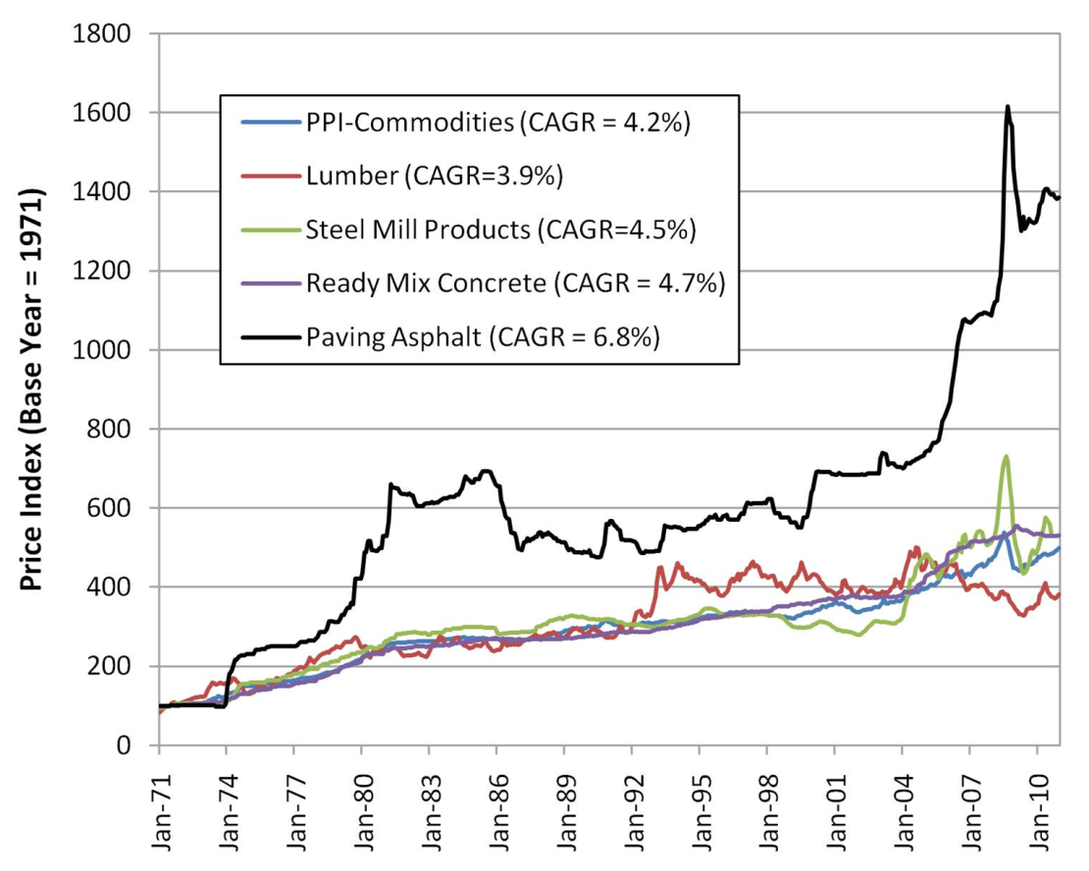
Are Real Costs Constant?
MIT investigated the historical inflation rates of:
  wood,
  steel,
  concrete, and
  asphalt.
Result - inflation rates are quite different.
Notes:
Recent research at the Massachusetts Institute of Technology (MIT) examined historical data on real prices and found that the assumption of constant real costs is inconsistent with historical experience. MIT investigated the historical inflation rates of several construction materials (wood, steel, concrete, and asphalt) and demonstrated that the historical inflation rates for these materials has been quite different (See Figure 1).

Slide 54
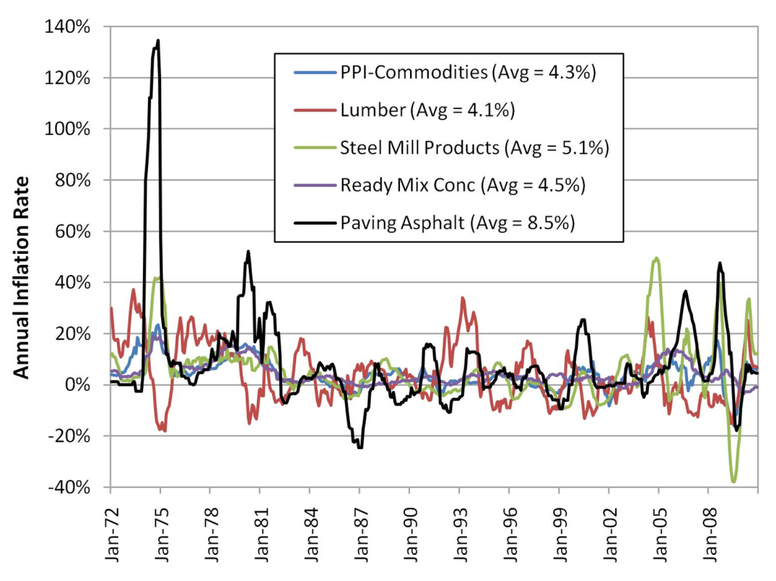
Are Real Costs Constant?
MIT also investigated the historical volatility of the same materials.
Result – volatility is also quite different, especially in the case of asphalt.
Notes:
and in the case of asphalt has been highly volatile (See Figure 2).

Slide 55
Methodology
Conducted a LCCA for an assumed 10-mile, four-lane highway project.
Concrete and asphalt alternatives analyzed using standard designs and maint/rehab schedules.
Performed Monte-Carlo stochastic simulation of 1,000 different LCCA outcomes and historical inflation rates.
Generated a variety of different random possible outcomes.
Notes:
To demonstrate the effect of variable inflation rates, MIT performed a LCCA for an assumed ten-mile, four-lane highway project. A concrete and asphalt alternative were analyzed using standard North Carolina DOT pavement designs and maintenance/rehabilitation strategies. MIT performed a stochastic simulation of 1,000 different LCCA outcomes using a Monte-Carlo simulation and historical inflation rates which generated a variety of different random possible outcomes.

Slide 56
Results – Inflation Rate
In 86% of the simulations the real price of concrete fell over the maintenance period.
In 85% of the simulations asphalt’s real price rose over the course of 40 years.
The cost surprise exceeded 4% of the initial projected cost (on a NPV basis) in half of the cases.
Notes:
It is likely that the actual costs for concrete maintenance would be lower than those assuming constant real costs (as in a typical LCCA)―in 86% of the simulations the real price of concrete fell over the maintenance period.
Asphalt inflation is likely to outstrip overall inflation, meaning that an LCCA assuming constant real costs will exaggerate asphalt’s price competitiveness―in 85% of the simulations asphalt’s real price rose over the course of 40 years.
Based on this analysis, the cost surprise exceeded 4% of the initial projected cost (on a NPV basis) in half of the cases, usually because the asphalt construction turned out to be relatively more expensive than concrete construction.

Slide 57
Results – Price Behavior & Volatility
Asphalt has risen 1.25% per year on average.
Concrete has declined nearly 0.20% in real terms over the same timeframe.
Concrete’s real price volatility is low at 2.9% while asphalt’s volatility is substantially higher at 6.3%.
Lumber and steel’s real price volatility is even higher at three times more than concrete.
Note: Data from the Bureau of Labor Statistics (BLS) for a period of more than 30 years.
Notes:
MIT analyzed the real price behavior of wood, steel, concrete and asphalt using data from the Bureau of Labor Statistics (BLS) for a period of more than 30 years and found: (See slide)

Slide 58
Results – Escalation Rate
Based on a 50 year analysis which accounts for differential inflation rates of construction materials:
  Asphalt’s real cost would rise by nearly 95%.
  The mean annual real escalation rate of concrete is –0.5% while asphalt’s rate is +1.1%.
Notes:
To account for the variable inflation rate of various construction materials, analysts could use an escalation rate to account for the difference in inflation between building materials and the general rate of inflation. MIT conducted another stochastic simulation for 1000 real cost paths for the four basic construction materials over a period of 50 years and found: (See Slide)

Slide 59
Impacts for Transportation Projects
In terms of equality for pavement type selection and LCCA, consider:
  Asphalt’s 40-year historical inflation rate is 2% to 4% higher than that of concrete.
  There is sufficient historical and forecasting evidence that demonstrates this difference will continue in the future.
Notes:
LCCA for road construction is used to determine which pavement design is most cost effective over the analysis period. For LCCA to be reliable, both the engineering inputs and the economic inputs need to accurately reflect the future performance and the time value of money. Current practice assumes that the inflation rate for all materials is the same; however, MIT has demonstrated that this is not the case and determined:
Asphalt’s 40-year historical inflation rate is 2% to 4% higher than that of concrete
There is sufficient historical and forecasting evidence that demonstrates this difference will continue in the future

Slide 60
Recommendations
Continue use of the Office of Management and Budget (OMB) recommended real discount rates in LCCA.
For pavements it is recommended to use the 30-year real discount rate.
For other structures it is recommended to use the 50-year real discount rate (or other appropriate timeframe).
Account for differences in inflation among materials and the general rate of inflation by using an appropriate escalation rate applied at the year(s) of rehabilitation.
Notes:
Recommendations for improving LCCA for construction material selection include: (See Slide)

Slide 61
More Information
Full report available from MIT Concrete Sustainability Hub at web.mit.edu/cshub
MIT Hub established by
  RMC Research & Education Foundations
  Portland Cement Association
NRMCA providing technical support
  Transfer research into practice
  Visit www.nrmca.org
Notes:
The full report titled The Effects of Inflation and Its Volatility on the Choice of Construction Alternatives can be downloaded from the MIT Concrete Sustainability Hub web site at http://web.mit.edu/cshub. The Concrete Sustainability Hub is a research center at MIT that was established by the Ready Mixed Concrete (RMC) Research & Education Foundation and the Portland Cement Association (PCA). NRMCA is providing technical input to the research program and helping transfer the research results into practice.

Slide 62
Strategies for Reaching Target Audiences

Slide 63
Reaching Design Professionals

Slide 64
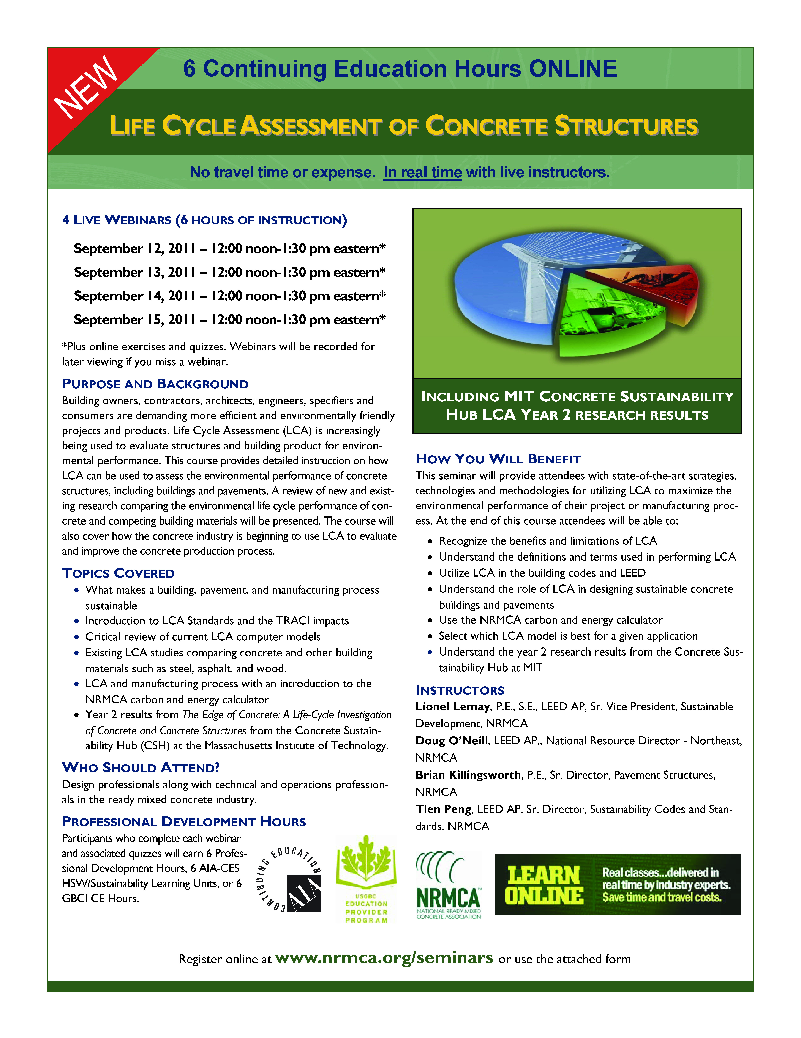
LCA Course
LCA standards
LCA models
MIT Interim results
September 12-15
Free for members and state affiliate staff
www.nrmca.org

Slide 65
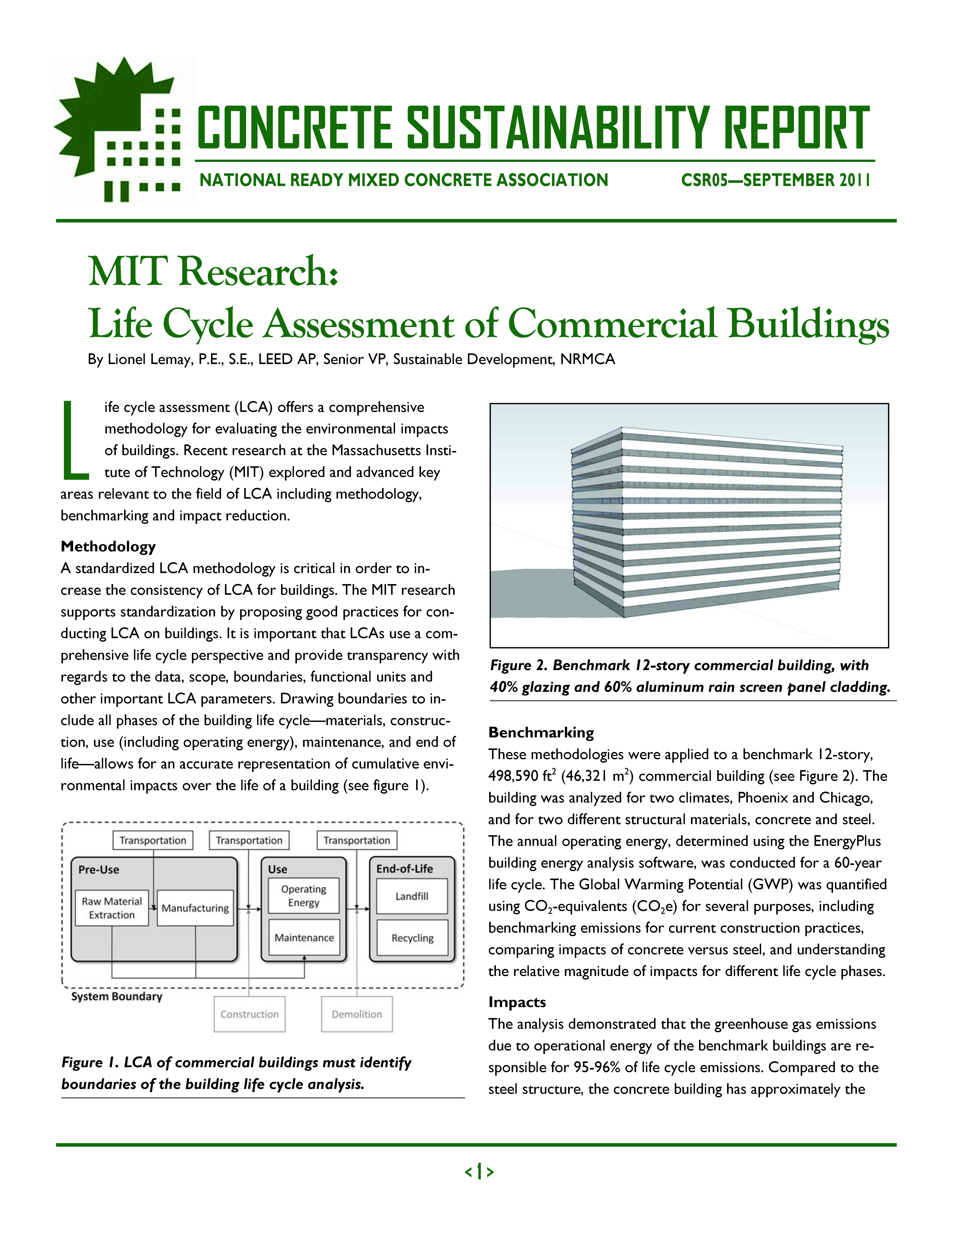
Technical Publications on LCA
1-Page Summaries
10-minute PPTs
30-minute PPTs
www.nrmca.org/sustainability

Slide 66
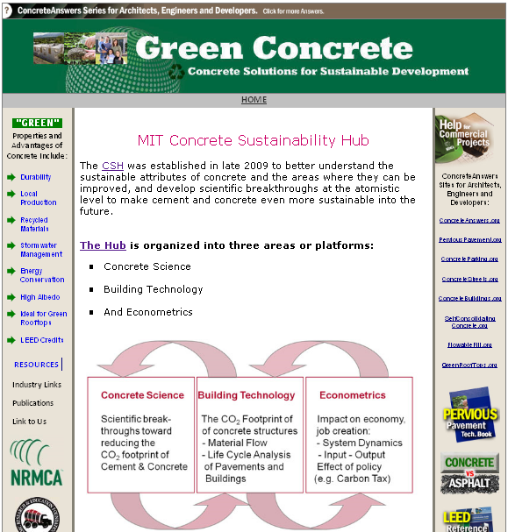
Greenconcrete.info
www.greenconcrete.info

Slide 67
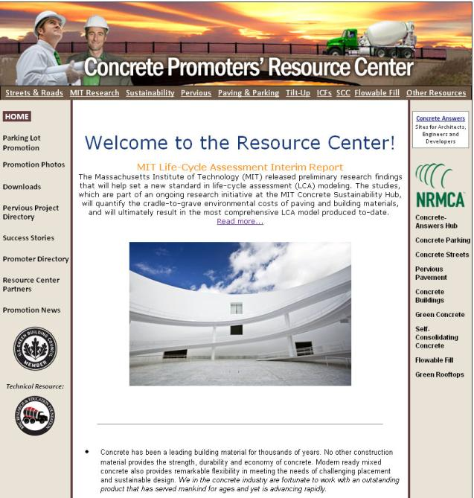
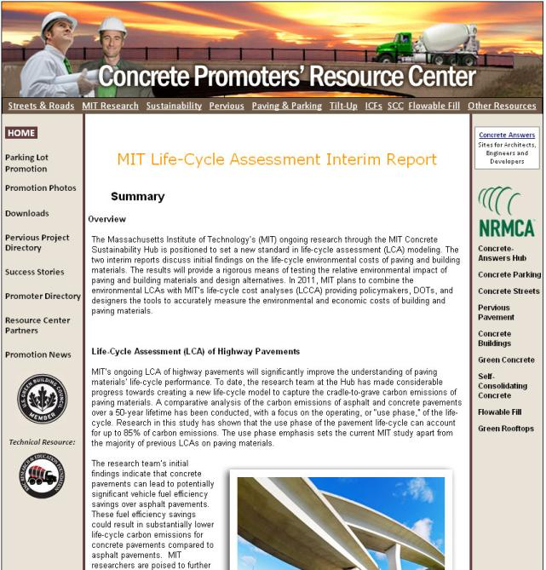
ConcretePromotion.org

Slide 68
Reaching Government Officials

Slide 69
State & Local Advocacy

Slide 70
Advocacy
Key Goals Produce Tangible Results
  Incorporate life-cycle assessment and life-cycle cost analysis in major infrastructure projects and national building codes and standards (IgCC, LEED).
  Identify key government officials
  Advocate state and local governments to adopt and amend latest building codes
  Establish the use of concrete as the building material of choice for construction and paving.
Notes:
Using the groundbreaking research of the MIT Concrete Sustainability Hub, NRMCA’s key goal is to help you produce tangible results establishing the use of concrete as the building material of choice for construction and paving.
To accomplish this task, I’m going to discuss tools NRMCA has, and examples so you can build an advocacy campaign setting the standard in quantifying the cradle-to-grave economic and environmental costs of building and paving materials. These tools will provide essential
I will also address how to identify key government officials on the state and local level to help you along in your efforts.
The information provided will help you articulate and demonstrate the transparency and long-term savings that the life-cycle approach to budgeting entails. We will provide the easiest advocacy/grassroots materials to identify the best strategy to achieve the shared goal of increasing market share for the ready mixed concrete industry.

Slide 71
Advocacy
Discovery on the local level to influence federal or state policy
  Identify obstacles to your participation in state and federal projects
  Identify how to change those barriers into open doors w/ policy makers
  Identify champions for your position
  Execute your resolution
Notes:
Beginning your discovery.
What is the issue? Is it a state or local level issue that requires attention? Can the issue be improved by incorporating simple Life Cycle Assessment or Life-Cycle Cost Analysis to help maximize government investment that has a long-lasting environmental and economic impact.
Identify the obstacle to your participation in projects
rule, statute or bureaucracy
How to identify fixing the problem
Creating a new law
Creating a new regulation
Creating an executive order
Creating or working with a commission
Amending current law
Amending standard operating procedures

Slide 72
Advocacy
Do you know all of your decision makers?
Do your decision makers know you?
Have your decision makers visited a member company or plant in the last year?
Notes:
Much more intense because it’s more personalized.
Town x – local codes, town council, member of board of burgesses (whatever town, county board of supervisors and someone represents them there as well. Develop relationships, invite them to your facility, start with a sit down to give them a practical way to interpret MIT and insert it into local codes. Give a plant tour
Local official, mayor, state rep, state senator, Government Official and Governor.
Build relationships.

Slide 73
Advocacy
Tools for Implementation
  Industry position statements on LCA
  White paper on LCA of concrete
  Any recommended changes to state and local building codes
  Building code specialists
  Other educational materials
    Talking points
      Flip charts, brochures, issue papers, etc.
    MIT grassroots resource website
      Template letters targeting state and local governments
      US map of states with most/least effective codes
Notes:
In order for you to produce tangible results we will provide the ‘basics’ for running an effective advocacy/grassroots campaign

Slide 74
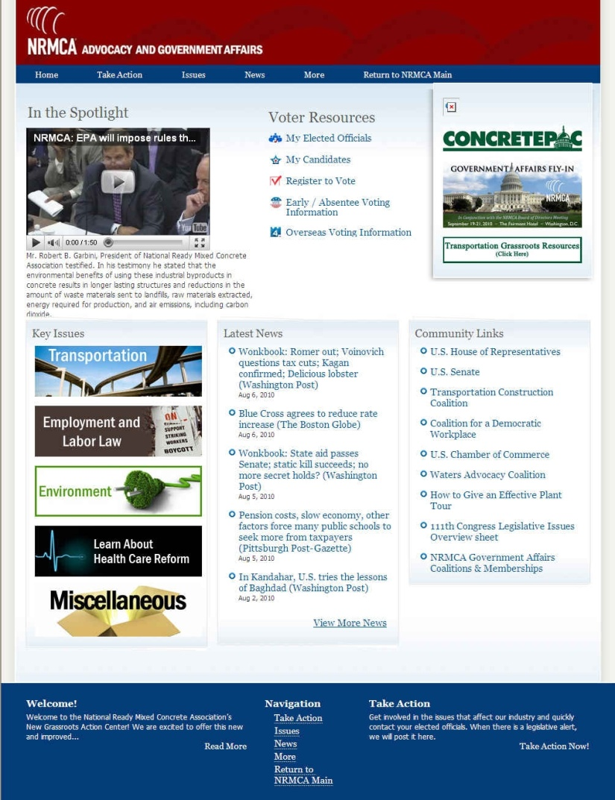
Advocacy
MIT Advocacy Resources
Notes:
The MIT LCA Research Advocacy/Grassroots Website has been modeled after NRMCA’s advocacy and grassroots website. The links provide an easy “click here” style format allowing you to flip from one page to the next in order to research various topics simultaneously. Overall, the website is a one-stop shop for all of your advocacy needs. The website provides advocacy and grassroots materials to help you educate and effectively lobby your state and local officials on the importance of incorporating life-cycle budgeting into major infrastructure and building projects. The MIT LCA Advocacy/Grassroots Website was designed to highlight the groundbreaking research of the MIT Concrete Sustainability Hub, which will set the standard in quantifying the cradle-to-grave economic and environmental costs of building and paving materials. The information provided will help you produce tangible results demonstrating the transparency and long-term savings that the life-cycle approach to budgeting entails. It provides the easiest advocacy/grassroots materials to identify the best strategy to achieve the shared goal of increasing market share for the ready mixed concrete industry. I highly recommend using the website for discovery and research while you development your local strategy.
For example, one handy tool on the website will help you with what we call the “ABC’s of How to Lobby” and also provides 12 steps for setting up and conducting an effect meeting with your local leaders. In fact, this document should be read first if you are trying to educate yourself on how to be effect lobbyist.

Slide 75
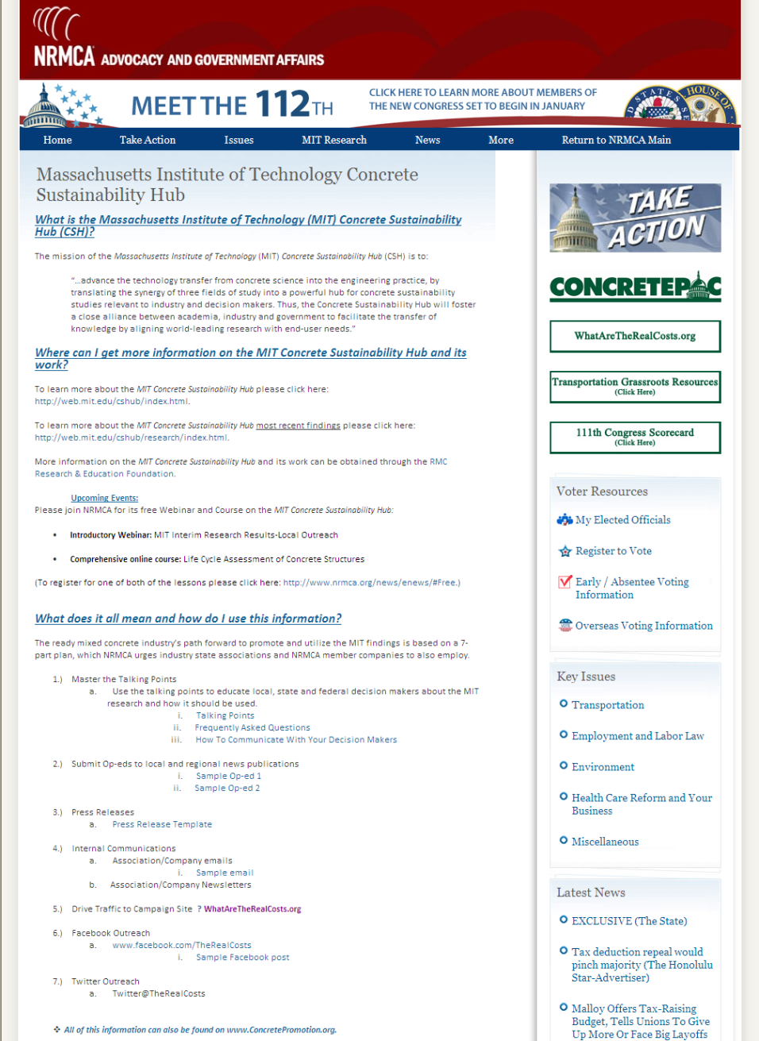
Advocacy
Notes:
When you click to the MIT LCA Research Advocacy page you will notice the site has incorporated the ‘Seven Ways to Get Involved’ campaign that Kathleen mentioned earlier. This time the talking points are centered around communicating with your state and local officials. Same talking points but you can also research additional supporting materials to help you deliver your message most effectively to your intended audience.
(Show a snapshot of the website and point to where everything is located.)
As more information is provided by MIT, we will update our site streamlining it’s effectiveness.
Master the Talking Points
Submit Op-eds to Local News Publications
Press Releases
Internal Communications
Company-wide Emails
Company Newsletters
Drive Traffic to Campaign Site
Facebook Outreach
Twitter Outreach

Slide 76
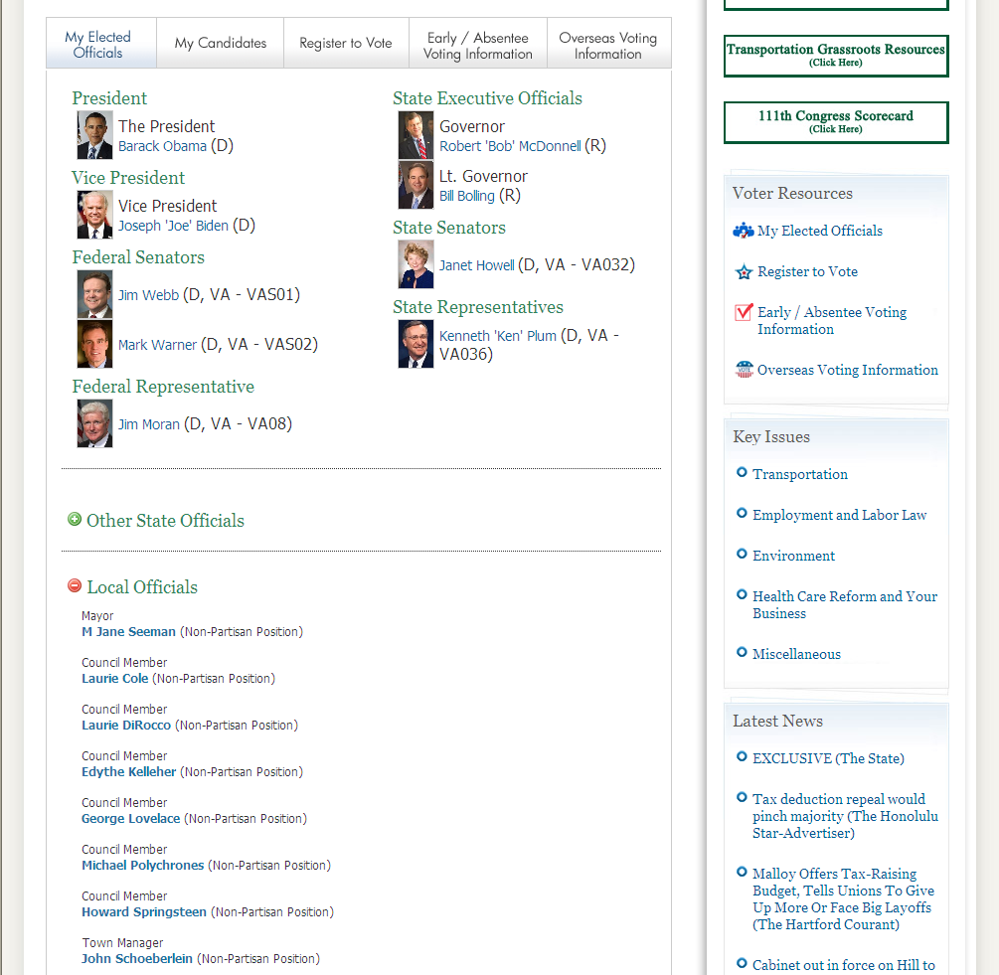
Advocacy
Notes:
For example, while researching the “talking points” and “how to communicate with your decision makers’ you can click on the ‘Elected Officials’ link and research which state and/or local official is the best recipient of your message. As you can see, this page allows you to view both your federal, state and local officials. It’s a great resource for establishing with whom you need to communicate and how to view their contact information.

Slide 77

Advocacy
www.whataretherealcosts.org
Notes:
If you look over to the side of the MIT LCA Research website you will see a direct link to the “What Are the Real Costs” website detailing life-cycle assessment. Again, you can find this on other portions of the NRMCA website but we placed it on the advocacy website as well for clicking convenience. We didn’t want you to have to go back to the NRMCA home page every time you have a quick question about the research.

Slide 78
Advocacy
U.S. House Appropriations Subcommittee on Financial Services and General Government
  FY 2012 Budget
  Chairwoman Jo Ann Emerson (R-MO)
Instructs the White House Office of Management and Budget to better anticipate the cost of major infrastructure projects by making greater use of life-cycle cost analysis, including examining material costs and maintenance
    Cleared subcommittee 6/23/2011
Notes:
On the federal level, life-cycle report language was inserted into the U.S. House Appropriations Subcommittee on Financial Services and General Government FY2012 Appropriations bill. Representative Jo Ann Emerson (R-MO) is the Chairwoman of the Subcommittee and agreed to insert the language on our behalf thanks to the strong constituent relationships. According to Appropriations Committee Staff, this is an unprecedented step and the first time directive OMB language has been included in this appropriations bill.
Under this provision, the Committee “expects OMB's review and modernization of Circular A-94 to emphasize the importance of incorporating life-cycle cost analysis. Moreover, this analysis should be as accurate, complete and reflective of the real costs and lifespans of materials as possible” including updating their guidance based upon new analysis using “material-specific discount rates and maintenance scheduled costs.” Importantly, the directive is comprehensive and applies to all major infrastructure projects and all agencies across the federal government. In addition, Chairwoman Emerson has agreed to send a letter to the Director of OMB urging him to begin this analysis immediately and to use the MIT life-cycle research (including 50 year valuation period) as the basis for updating the OMB standards. This fits well into the timing of the August release of the MIT research and will jump-start the OMB review process.
The language is below:
In light of increased efforts to identify government-wide efficiencies and properly anticipate the cost of major infrastructure projects, the Committee instructs OMB to examine and revise Circular A-94 as necessary and appropriate to improve the guidance provided to agencies in conducting benefit-cost analysis. The Committee expects OMB's review and modernization of Circular A-94 to emphasize the importance of incorporating life-cycle cost analysis. Moreover, this analysis should be as accurate, complete and reflective of the real costs and lifespans of materials as possible, including the use of material-specific discount rates and maintenance scheduled cost. OMB is directed to report to the Committee within 180 days of enactment of this Act on the status of reviewing Circular A-94.

Slide 79
Advocacy
Fiscal Accountability and Transparency in Infrastructure Spending Act of 2011 (S. 615)
  Introduced 3/17/2011 by Sen. David Vitter (R-LA)
Aims to “[account] for every tax dollar spent over the life-cycle of a major building, road, or infrastructure project and would drive down the costs through implementation of innovative, proven policy tools.”
Would require a 50-year LCCA of projects before the $$$ is obligated
Gives states more flexibility to use “alternate infrastructure type bidding procedures
Requires states use MEPDG for initial design phase
Notes:
Through careful work likely candidates were identified who might be agreeable to the life-cycle argument. To that end Sen. Vitter was contacted and courted by Mercury and agreed to introduce S. 615. Simply put this bill would make sure that we use the little transportation funds we have as efficiently as possible so that the value of every dollar dedicated to our infrastructure is maximized.
To achieve this, the bill would require the federal government to examine the life-cycle cost analysis of major building, road, and infrastructure projects over a 50-year life span.
As well, it relaxes current state standards so states can use alternate bids the better fit their individual budgets.
And it would require that states use the Mechanistic Empirical Pavement Design Guide (MEPDG) for the initial design phase.

Slide 80
Advocacy
Commonwealth of Virginia
  House Bill (HB) 1965
  Adds “life cycle costs” to the facilities estimates prepared as part of the capital improvement program.
  Virginia General Assembly 2011
    Passed House Vote 1/26/11
    Passed Senate vote 2/18/11
    Signed by Governor Bob McDonnell 3/26/11
Notes:
There have also been successes on the state level with the Commonwealth of Virginia adding life-cycle legislation to the budget planning process.
Virginia HB 1965
The Virginia Association of Planners (VAP) was looking to tighten up the planning and budgeting process that the Commonwealth’s counties and cities used when planning capital projects. At the same time members of the Virginia General Assembly were being briefed on the need for LCCA and being encouraged by federal officials into action.
Delegate Tom Rust, a former Mayor and Civil Engineer, was briefed on LCCA by our grassroots team and recruited by the VAP to carry legislation.
The result was HB 1965 which added “life cycle costs” to the annual facilities estimates prepared as part of the capital improvement program by local planning commissions throughout the state. The Governor signed the legislation into law and now all county and city capital projects require a Life Cycle Cost attached to proposed projects. Localities will now have an accounting of actual costs and will be able to choose better approaches to capital costs.
Be it enacted by the General Assembly of Virginia:
1. That § 15.2-2239 of the Code of Virginia is amended and reenacted as follows:
§ 15.2-2239. Local planning commissions to prepare and submit annually capital improvement programs to governing body or official charged with preparation of budget.
A local planning commission may, and at the direction of the governing body shall, prepare and revise annually a capital improvement program based on the comprehensive plan of the locality for a period not to exceed the ensuing five years. The commission shall submit the program annually to the governing body, or to the chief administrative officer or other official charged with preparation of the budget for the locality, at such time as it or he shall direct. The capital improvement program shall include the commission's recommendations, and estimates of cost of the facilities and life cycle costs, including any road improvement and any transportation improvement the locality chooses to include in its capital improvement plan and as provided for in the comprehensive plan, and the means of financing them, to be undertaken in the ensuing fiscal year and in a period not to exceed the next four years, as the basis of the capital budget for the locality. In the preparation of its capital budget recommendations, the commission shall consult with the chief administrative officer or other executive head of the government of the locality, the heads of departments and interested citizens and organizations and shall hold such public hearings as it deems necessary.
Localities may use value engineering for any capital project. For purposes of this section, "value engineering" has the same meaning as that in § 2.2-1133.

Slide 81
Advocacy
State of Alabama Legislative Session
  House Bill (HB) 13 – Regular Session
  Allows officials to choose the lowest life-cycle cost bid on infrastructure projects, including: public buildings, structures, sewers, waterworks, roads, curbs, gutters, side walls, bridges, docks, underpasses, and viaducts
  Alabama General Assembly 2011
    Passed House Vote 3/31/11
    Passed Senate vote 6/02/11
    Signed by Governor Robert Bentley 6/09/11
Notes:
Another example of a state-level victory happened in Alabama.
Earlier this summer, the Alabama State House and Senate passed H.B. 13, which will allow officials to choose the lowest life-cycle cost bid on infrastructure projects, including: public buildings, structures, sewers, waterworks, roads, curbs, gutters, side walls, bridges, docks, underpasses, and viaducts. On Thursday, June 9, Governor Bentley signed H.B. 13 into law.
Alabama HB 13
Representative Jack Williams was briefed on Life Cycle Policy last year and asked to author an article on Life Cycle Budgeting. He was interested, initially, in the fiscal soundness of the LCCA approach because Jefferson County's debt escalation in the mid-2000s when it refinanced a bond debt incurred as it upgraded its sewer system through a series of auction and interest rate swaps.
Because of the transparency in a LCCA Williams introduced a bill, HB 13, to address the sewer system disaster and other water projects for very detailed accounting of tax payer dollars.
Legislation passed the state house applying life cycle to all water and sewer project and was amended in the state senate to include all public works projects.
The bill was signed into law by the Governor.
Because the legislation initially was originally targeted at Jefferson County as a major reform it had minimal opposition was raised and it sailed through the process.

Slide 82
Make Your Voice Heard!
Create Your Own Grassroots Network
Initiate Letter Writing Campaigns
Meetings with Members of Congress
Host Plant Tours
Volunteer on Campaigns
Get Out the Vote (GOTV)
Notes:
Use the NRMCA website to have your voice heard. The materials provided on NRMCAVoice.com are here to help you:
Create Your Own Grassroots Network;
Initiate Letter Writing Campaigns;
Set up meetings with state and local officials;
Invite them on plant tours and talk about the issues;
Volunteer on the campaigns of your local champions;
Most importantly, talk to your employees and/or members about who your local champions are and what office they hold – always be sure to Get Out the Vote (GOTV)

Slide 83

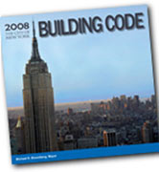

Local Building Codes:
Outreach Opportunity
Notes:
The state and city building code councils are established to provide objective advice to the legislature, the mayor and/or the Governor’s office on building code issues. Codes are technical and the legislatures do not have the expertise or time to make determination on building codes which establishes the minimum building, mechanical, fire, plumbing and energy code requirements necessary to promote the health, safety and welfare of the people of the state.

Slide 84

Code Councils and Committees
Notes:
Code writing is a dynamic process, involving constant interaction between the public and private sectors of the construction industry. Federal, state and local governments and individuals involved in code writing and revision represent the views of labor, management, manufacturers and trade associations, contributing much time and technical expertise to the process – mostly as volunteers.
Code Councils provides independent analysis for reviewing, interpreting and adopting the Model building codes- that is, the codes created by a standards organization such as ICC who brought us the IBC, IRC, IECC, IMC, IFC, IgCC and so on.
But they don’t have all the expertise to make the necessary decisions. They only make decisions with their own background (some with technical expertise, many without) and what is provided through testimony.

Slide 85
Washington State Example
3 Opportunities
  To serve:
    Council Member (e.g. Industry member)
    Technical Advisory Group (TAG) Member (e.g. specialized expertise)
  To advise:
    Provide testimony in open public meetings
    Provide data you have collected
  To consult:
    Analyze or collect data
Notes:
The process is this:
New code updates occur once every 3 years and the council along with the TAGs review the updates, adopts, amends or revises the model code. It sits through a legislative session (that is, it gets voted on) and then gets adopted for implementation the following year.
Proposed amendments to the code must be received by March 1 each year to be considered for adoption by December 1 of that year.

Slide 86

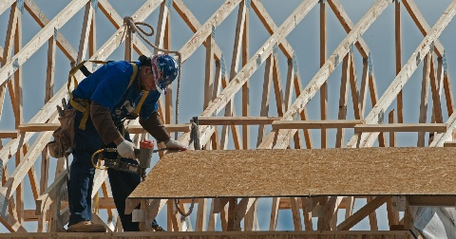
Residential Example
Notes:
Experts say that there is an easy way to increase our energy independence: that is the tightening up building codes, so that they require more effective performance, insulation and other improvements.
In Michigan and Washington State, the home builders association tried to stop the enforcement of tougher energy codes through the courts. After years of litigation, the court ruled against the builders, and the codes took effect last year.
On the flip side, there is a strong movement towards sprinklering residential homes for a variety of reasons (not because there are more deaths from residential fires). The firefighters were very well organized, showed up at every public meeting (in full dress uniform), gave compelling testimony and provided supporting data. Though the home builders were in strong opposition due to cost issues, their cost arguments were not as compelling.

Slide 87
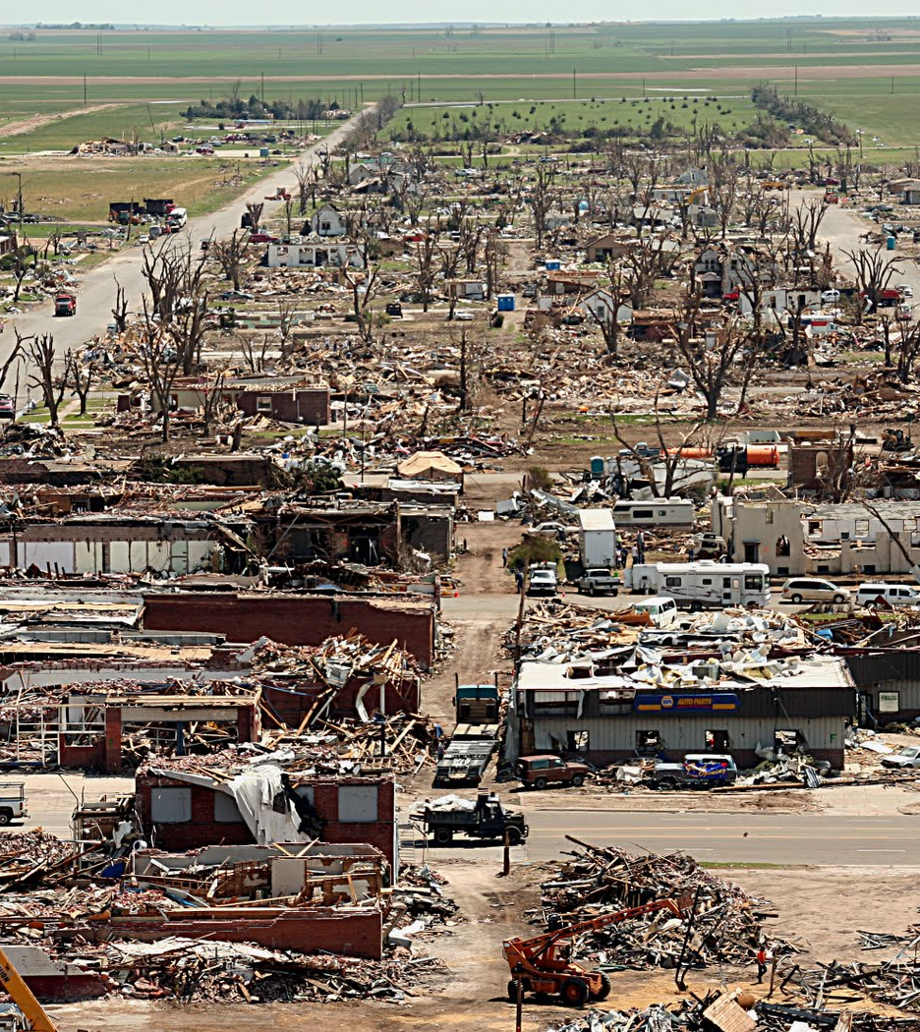
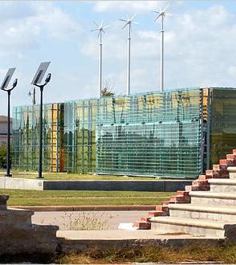
Greensburg, Kansas
Notes:
On May 4, 2007, a tornado destroyed or damaged 95% of the town's homes and businesses in Greensburg Kansas. Greensburg turned disaster into opportunity and created a vision to rebuild as a sustainable community.
After approving an ordinance requiring that all municipal buildings above 4,000 square feet be built to LEED Platinum standards, the town has now become both a laboratory for sustainability and a showcase of LEED-worthy projects. In fact, Greensburg features several new structures that incorporate sustainable energy sources, high-efficiency building materials and machinery, and other green moves.
New commercial buildings and homes will use 30%–40% less energy than those built to code.
Concrete Example: Silo Eco-Home - http://www.greenmagonline.com/?p=1463
The eco-home, with its six-inch thick concrete walls, can withstand the high winds of a tornado, yet still provide an aesthetically appealing design.

Slide 88
Adopting UHI Ordinance
Objective: Have city adopt an ordinance to reduce UHI
Why: Favors light colored pavements, pervious pavements, green roofs, etc.
  Present benefits of UHI mitigation to city legislator
    MIT 1-Pager on LCA of Concrete Pavements (CSR07)
    NRMCA report on UHI Mitigation (CSR09)
  Suggest NRMCA UHI Ordinance

Slide 89
Fight Anti-Concrete Legislation
Situation: State bill introduced favoring wood for all publically funded buildings
Objective: Defeat the Bill
Why: Favors other materials
  Present MIT LCA research on residential buildings
  Offer alternative legislation requiring full life cycle analysis (NRMCA LCA Ordinance)

Slide 90
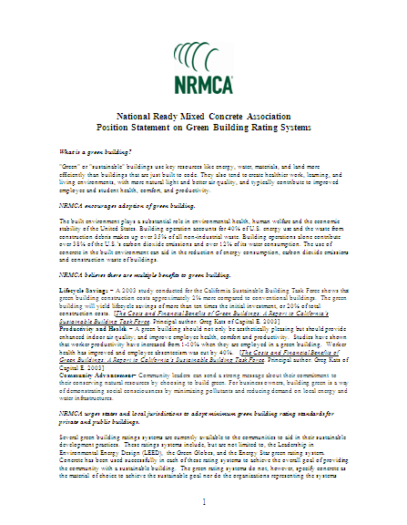
NRMCA Model Ordinances and Bills
Statewide Code Adoption
Green Building Rating System
Pervious Pavements
UHI Ordinance
LCA Ordinance
www.nrmca.org/codes

Slide 91
Reaching General Public
Letters to the editor
Op-ed articles
NRMCA samples
www.concretepromotion.org

Slide 92
Online Resources
www.ConcretePromotion.org
www.greenconcrete.info
www.nrmca.org/sustainability
www.whataretherealcosts.org
web.mit.edu/cshub
www.rmc-foundation.org
Notes:
Here are a few websites that can help answer any questions you might have, where you can get updates on the research and find tools you can use to help spread the word.

